Slide 1
The characteristics of GRB with presence of
high energy component
in their spectra
Arkhangelskaja I.V.
National Nuclear University “MEPhI”

Slide 2
Three periods of GRB observation in high energy band:
1991 – 1999 → CRGO: ►OSSE 0.05–10 MeV
►COMPTEL 0.7–30 MeV
►EGRET/TASCS 1-200 MeV
EGRET/spark chambers 0.02-30 GeV
►BATSE (SD&LAD) 0.01-10 MeV
2001 – 2005 → CORONAS-F: ► AVS-F 0.1–250 MeV
► SONG 0.05–150 MeV
► IRIS 0.1–10 MeV
► HELICON 0.1–10 MeV
2007 – now → AGILE: ►GRID 0.03-30 GeV
(2007) ► calorimeter 0.25-200 MeV
→ Fermi: ► GBM 0.008-40 MeV
(2008) ►LAT 0.1-100 GeV
→ CORONAS-PHOTON: ► Natalya-2M 0.3-20000 MeV
(2009-2010) !!!! no processed data !!!!

Slide 3
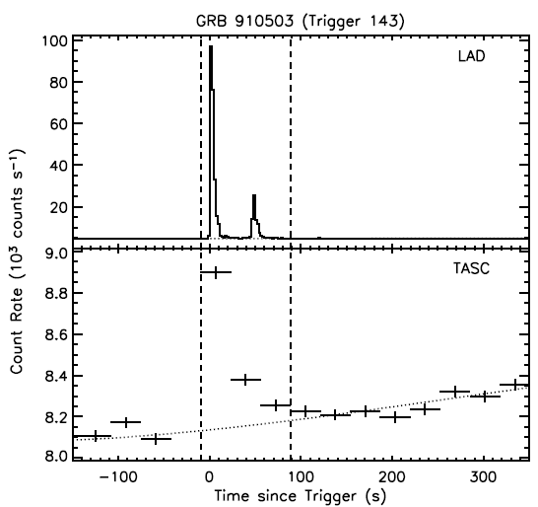
GRB WITH HIGH ENERGY TAILS ON CGRO DATA
1991 by common analysis of CGRO data ⇒ GRB with presence of high energy component (more than some MeV) in spectra
(43 BATSE GRB with f>10 ph/cm²s for E>300keV → 26 can be seen by EGRET
and 25 has E>2 MeV
15 has E>120 MeV).
Some tens GRB were detected simultaneously by all 4 experiments onboard CGRO (BATSE, COMPTEL, OSSE and EGRET)
↑↓
the widest energy range for γ-emission registration on satellite experiment for the same GRB was ~10 keV ÷ ~20 GeV.
The temporal profiles of
GRB910503 (BATSE trigger #143)
on BATSE and EGRET data.

Slide 4
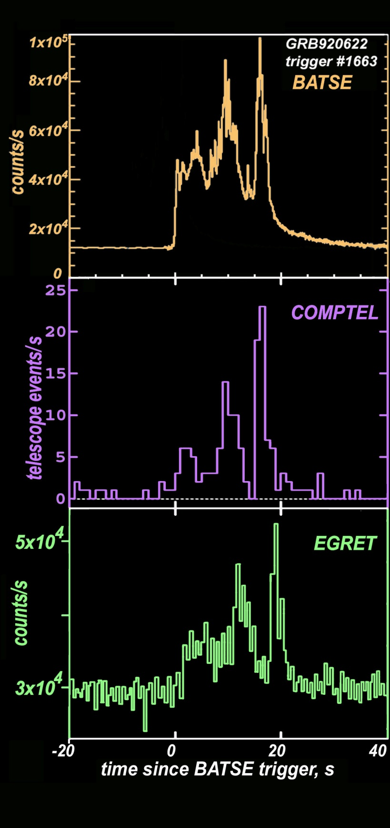
Most part of GRB:
common structure of temporal profiles consistent in various energy bands:
the same amount of global peaks
approximate ratio of relative peaks intensity are the same too:
first → lowest, last → highest
intensity
The temporal profiles of
GRB920622 (BATSE trigger #1663)
on BATSE, COMPTEL and EGRET data.

Slide 5
Typical GRB spectra
Usually GRB spectra (both time resolved and time integrated) are well described by two-component Band function (smoothly joint broken power law ):
first component ∼ combination of power law with index α
and
exponential cutoff defined by E=E_{peak}/(2+α)
second component ∼ power law with index β
  some GRB → “comptonized” model:
  exponential cut-off at high-energy
  some GRB → pure power-law (E_{peak} not constrained)

Slide 6
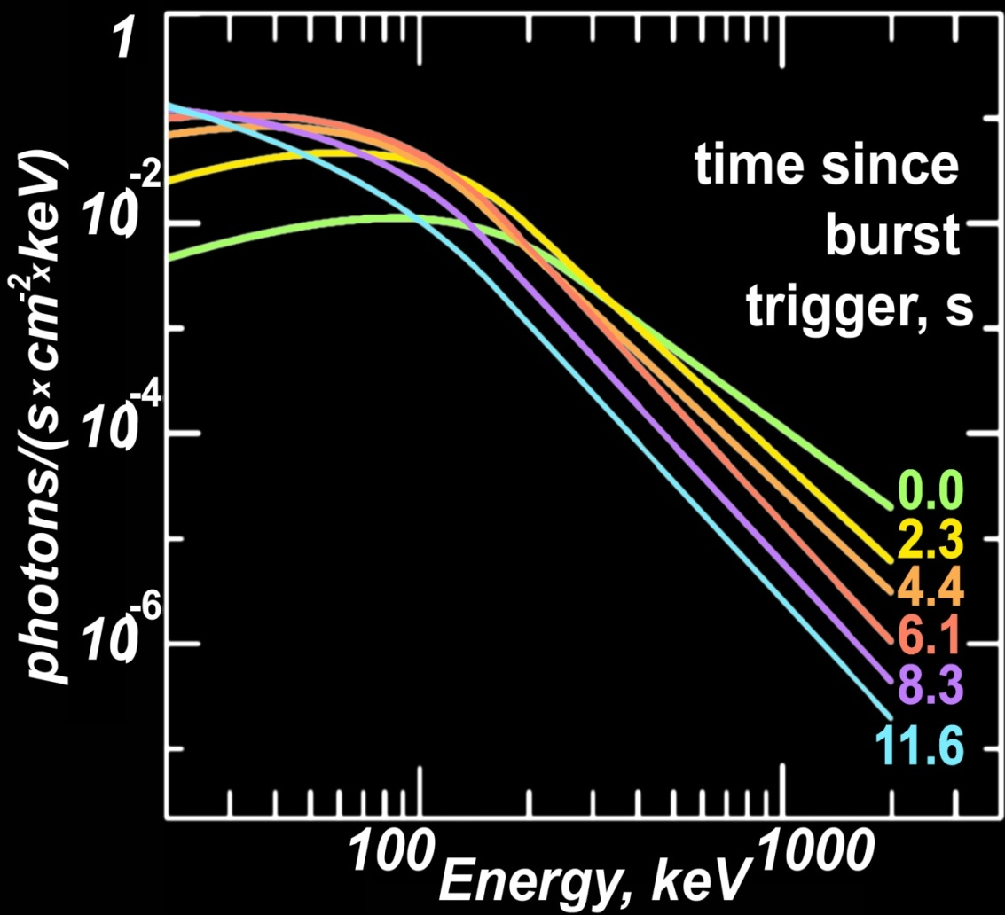
Typical spectral evolution
Hard to soft and hardness-intensity correlations are presented for most part of GRB, power law indexes in Band model decrease to GRB end.
spectral evolution for GRB910927:
hard to soft

Slide 7
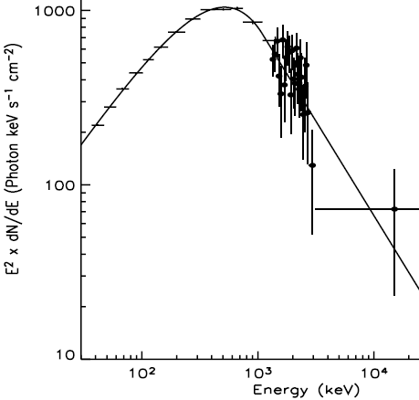
Spectra of
most part of
GRB - correspond Band model in high
energy band too
The energy spectra of GRB910601

Slide 8
Earlier works on spectral evolution:
↓
characteristics:
hardness - ratio between two detector channels
or some more physical variables
spectral break
peak power energy E_{peak} - maximum of E²×F_{n},( E - photon
energy, F_{n} - specific energy flux)
Parameters are typically decreasing monotonically while the flux rises and falls or its behavior corresponds to flux temporal profile.
Moreover, for most part of GRB E_{peak} decays exponentially in bright, long, smooth GRB pulses as a function of photon fluence F.

Slide 9
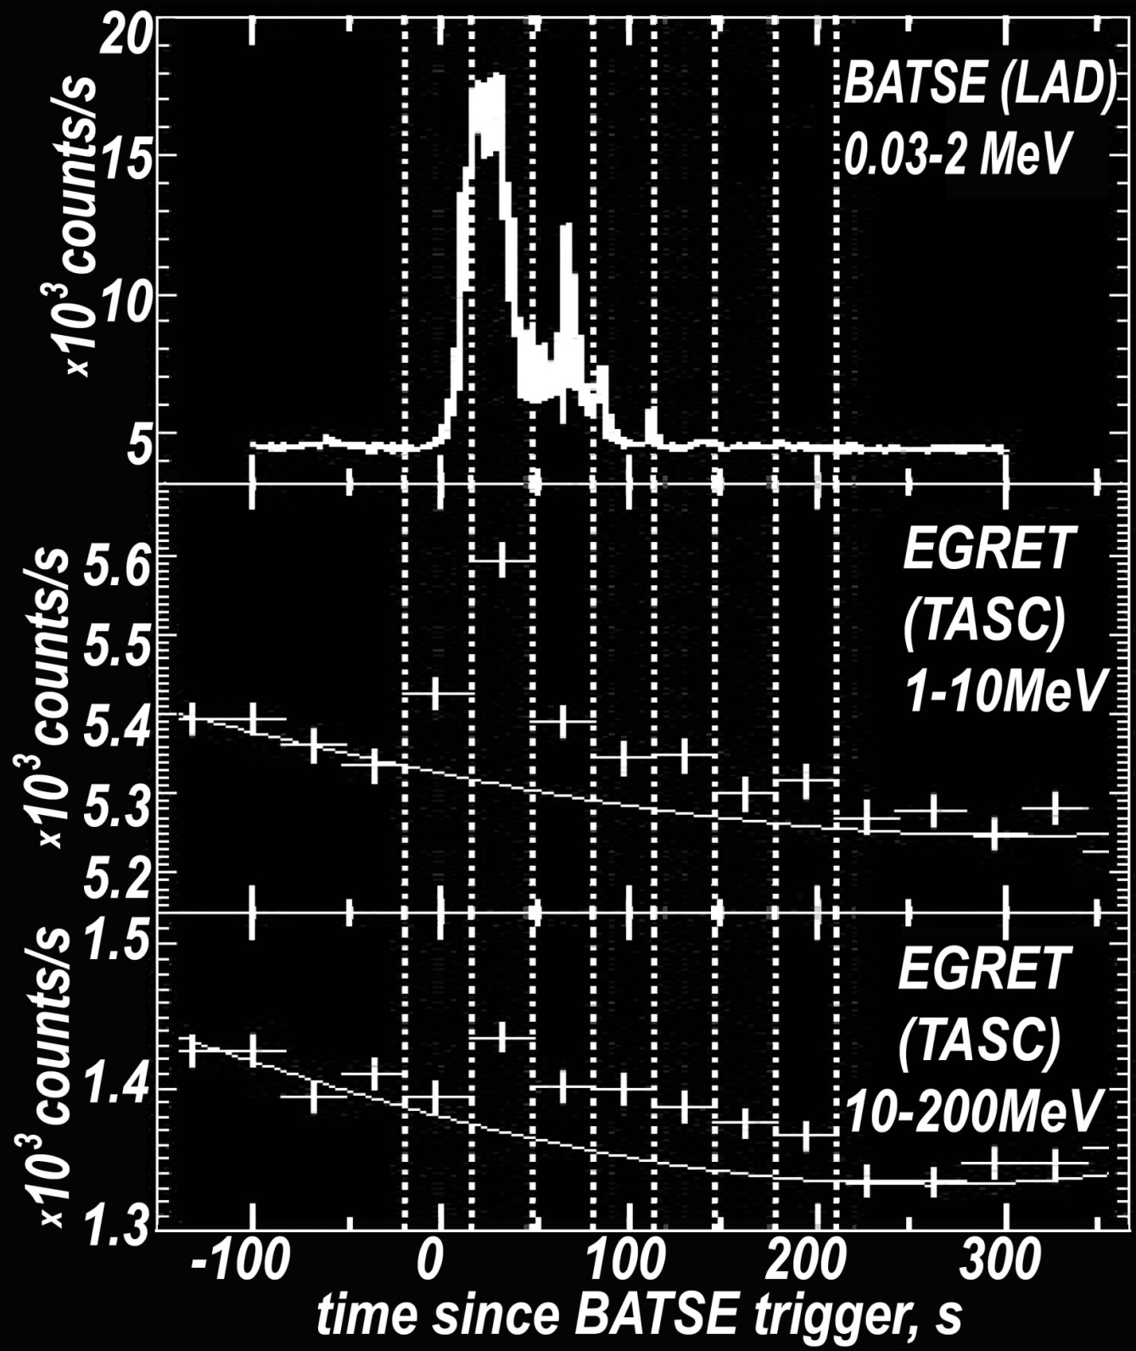
In some GRB spectra the new spectral components not corresponded to Band model was found
GRB 941017: the common structure of temporal profiles not in agreement in various energy bands:
HE tail
The temporal profiles on BATSE and EGRET data of GRB941017

Slide 10
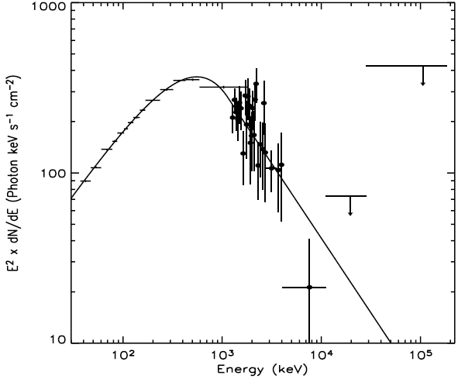
The energy spectrum of GRB941017 on BATSE and EGRET data

Slide 11
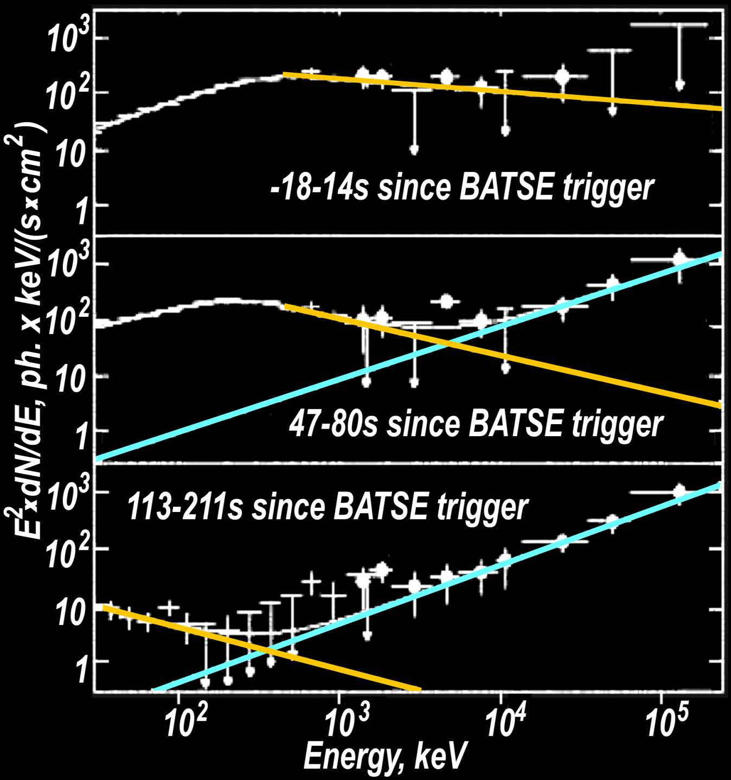
Spectrum of this GRB has additional component in the high energy region.
Spectral index of the HE component: γ≈-1
Cut-off at higher energies: where?
The difference between these two types of spectral shapes is well seen.
The energy spectra of GRB941017:
second component of Band model and
approximations for high energy part

Slide 12
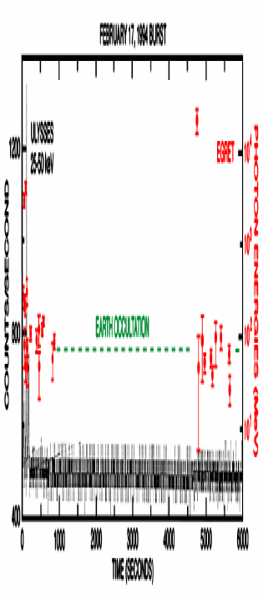
GRB940217 (BATSE trigger #2831, t₉₀≈150s)
γ-ray emission (> 50 MeV) till 1.5 hours after start of burst, highest-observed energy: 18 GeV
temporal profiles with different time structure in various energy bands → extended emission
Registration of GRB940217 by EGRET and ULYSESS
Evidence of TeV emission from GRB 970417a using data from the Milagrito: photons with energies above 650 GeV were detected

Slide 13
GRB WITH HIGH ENERGY TAILS ON CGRO DATA
15 GRB has E>120 MeV (Kaneko et al, 2008)
  3 GRB with E_{max} ~130÷140 MeV→ no emission E>200 MeV
the widest energy range for γ-emission registration on satellite experiment for the same GRB was ~10 keV ÷ ~20 GeV
spectral parameters are typically decreasing monotonically while the flux rises and falls or its behavior corresponds to flux temporal profile.
some GRB - new additional spectral component (920902, 941017 and 980923)
mostly common structure of temporal profiles is similar in various energy bands (exluding GRB with no-Band component in the spectra):
the same amount of global peaks
approximate ratio of relative peaks intensity are the same too
some GRB → extended high energy emission E_{max} ~18 GeV
TeV emission!?

Slide 14
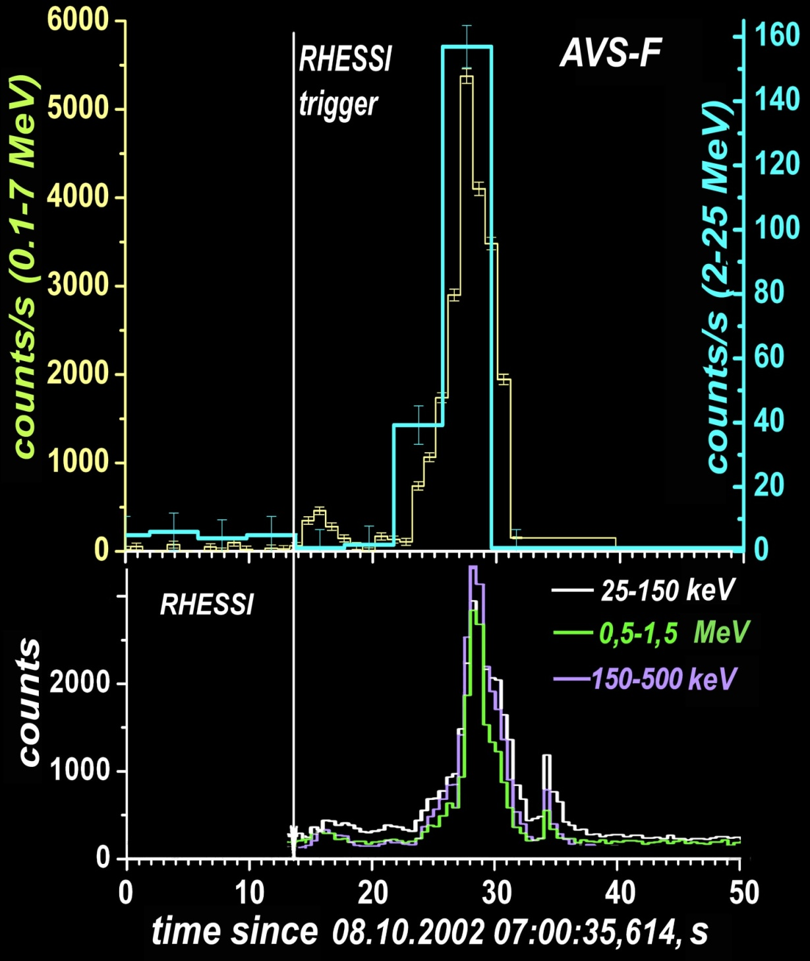
THE NEXT STEP –
COROPNAS-F
GRB021008 : t_{90 RHESSI} ≈ 13s,
t_{90 AVS low} ≈ 12s, t_{90 AVS} _{high} ≈ 8s;
the common structure of these burst temporal profiles is in agreement in various energy bands,
low energy precursor
The temporal profiles on AVS-F data
and RHESSI ones for GRB021008

Slide 15
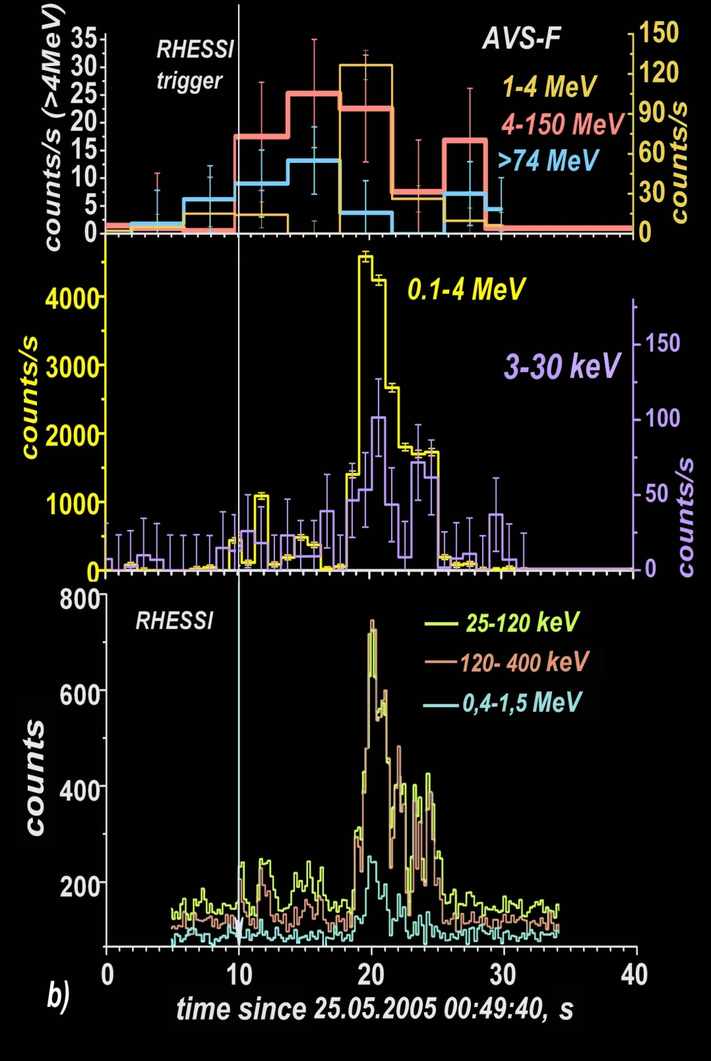
During AVS-F data analysis some GRB with different temporal profiles behavior of prompt emission in various energy bands and with not coincidence of maxima were found.
There are some maxima in GRB050525 temporal profile in low energy band on RHESSI data and one at 20 s has highest intensity. But in high energy band (>4 MeV) and in very low energy band (3-30 keV) temporal profiles of this burst quite different and moment of maximum intensity differ from one in low energy band.
The temporal profiles on AVS-F] and RHESSI data for GRB050525

Slide 16
The summarized spectrum of this burst has additional component in the high energy region too
E_{break}=2.4±0.1 MeV
hard to soft evolution weakly defined
The energy spectrum of GRB050525 by AVS-F data:
second component of Band model and approximation for high energy part
Analysis of CGRO and CORONAS-F databases
↓
E_{break}~3÷10 MeV

Slide 17
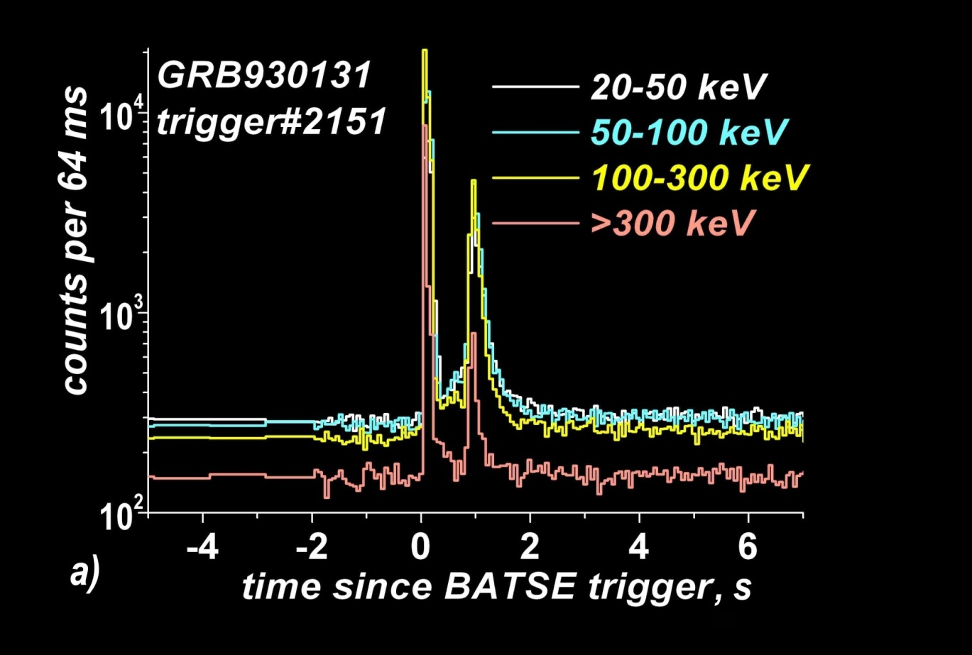
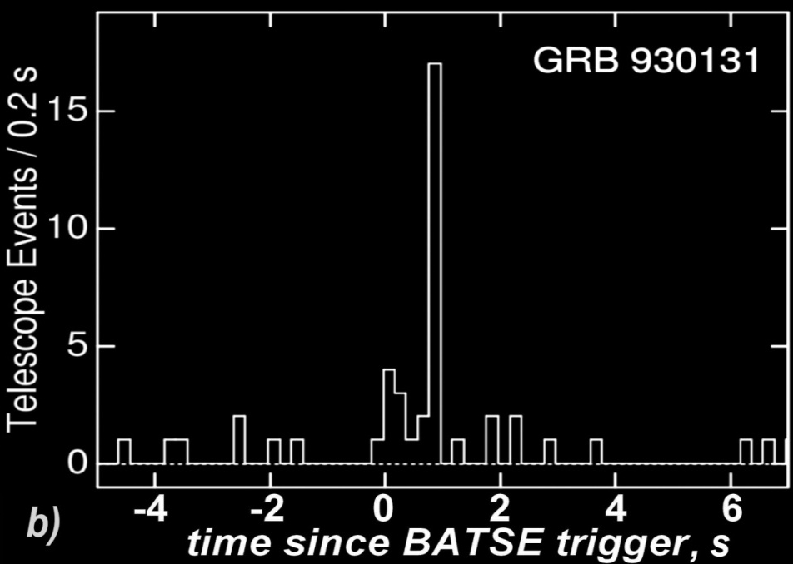
BACK to the analysis of CGRO database:
some GRB with high energy emission have temporal profiles with different time structure of prompt emission in various energy bands too.
GRB930131 : there are two peaks both in BATSE and COMPTEL ranges but relative intensities of these peaks maxima
I₁/I₂ ~ 5 in low energy band (BATSE)
and
I₁/I₂ ~ 0.3 in high energy band (COMPTEL).
GRB930131 (#2151) temporal profiles on BATSE (a) and COMPTEL (b) data.

Slide 18
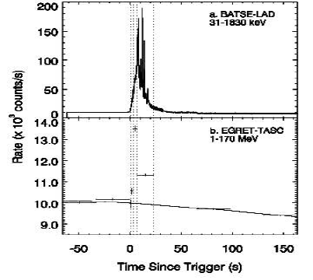
hard to soft evolution is absent or
weakly defined
GRB930506 : no monotonically decay for
E_{peak}, α and β
↑
last spectrum - hardest
GRB940921and GRB930506 spectral properties evolution.
GRB | t, s | α | β | E_{peak}, keV
940921 typical | 3-7 7-23 | -1.01±0.03 -1.11±0.01 | -2.24±0.08 -2.66±0.12 | 814±71 732±30
930506 | 1-3 3-7 7-23 | -1.06±0.04 -0.89±0.01 -1.24±0.01 | -1.90±0.06 -1.84±0.02 -1.82±0.01 | 540±58 1064±38 850±32
spectra of all GRB with presence of additional high energy component
↓
hard to soft evolution is absent or weakly defined
?↑?

Slide 19
GRB WITH HIGH ENERGY TAILS ON AVS-F/CORONAS-F DATA
(Similar to CGRO) some GRB has E>50 MeV (Arkhangelskaja et al, 2007,2010).
different temporal profiles behavior
of prompt emission in various energy
bands in the region
tens keV ÷ some MeV
and with not coincidence of maxima
burst with only low energy precursors
(up to several hundreds of keV)
some GRB → hard to soft evolution is
absent or weakly defined
(Similar to CGRO) some GRB → additional HE component
in spectra
Later was found in
CGRO database too…
Later was found in
CGRO database too…
Should be introduced additional spectral characteristic E_{break} (changed during burst): E_{break}~3÷10 MeV (CGRO and AVS-F databases)

Slide 20
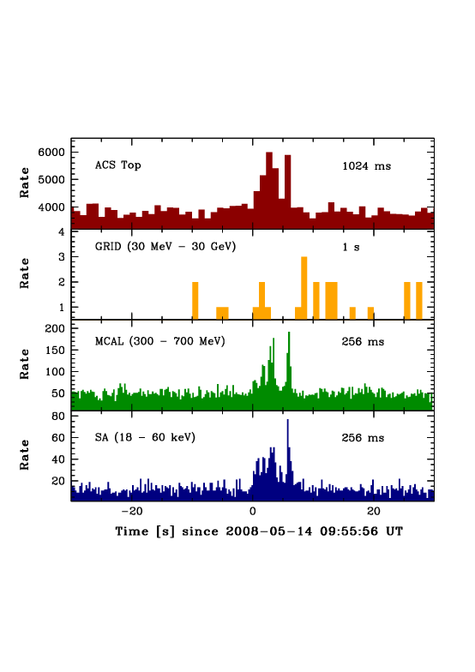
PRESENT TIME → satellite experiments Fermi and AGILE.
Agile
GRB080514B
(Marisaldi et al, 2009)
Extended
Emission
30 MeV-30 GeV
HE precursor?

Slide 21
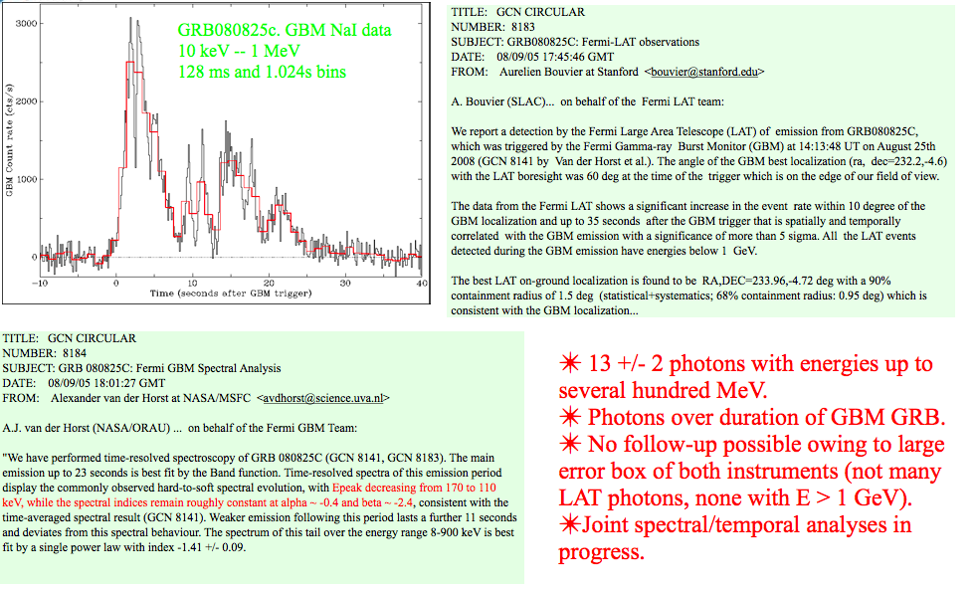
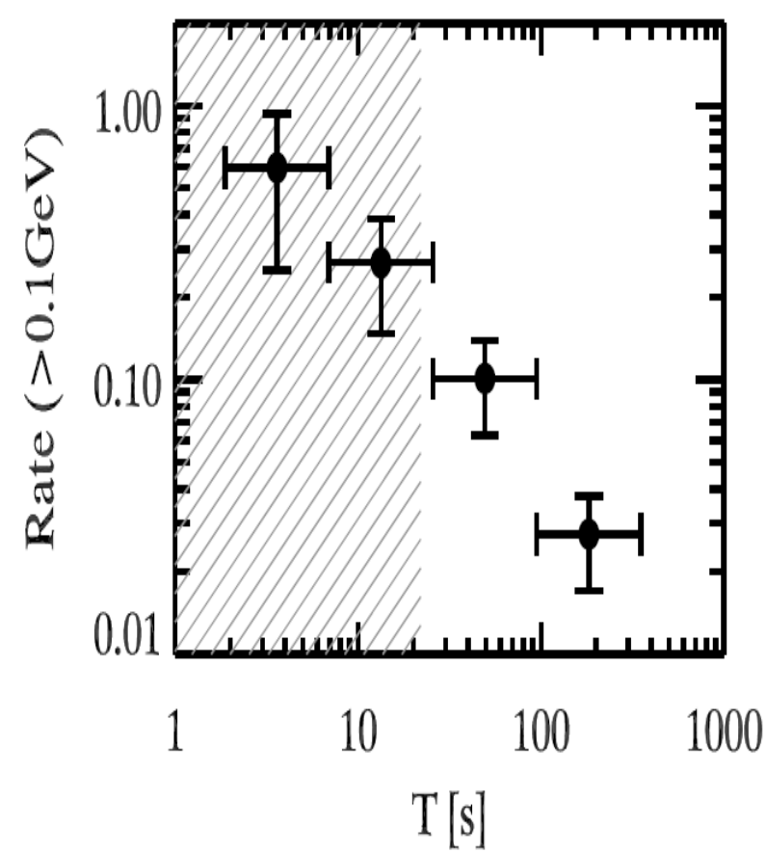
(Ghisellini,2010)
GBM
LAT
HE emission
13±2 photons (>5σ level) with energy up to some hundred MeV were detected since 35 s after burst trigger,
No emission with E>1GeV

Slide 22
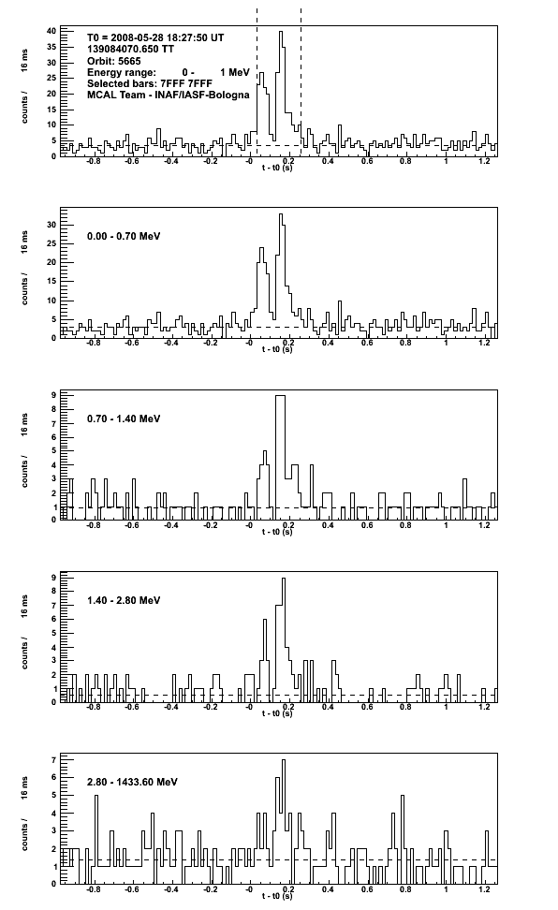
AGILE:
GRB 080528
Bin = 16ms
2 s
Shortest GRB detected by MCAL (t₉₀~ 250 ms)
Significant detection
2.8 MeV band
No temporal profile difference in various energy bands

Slide 23
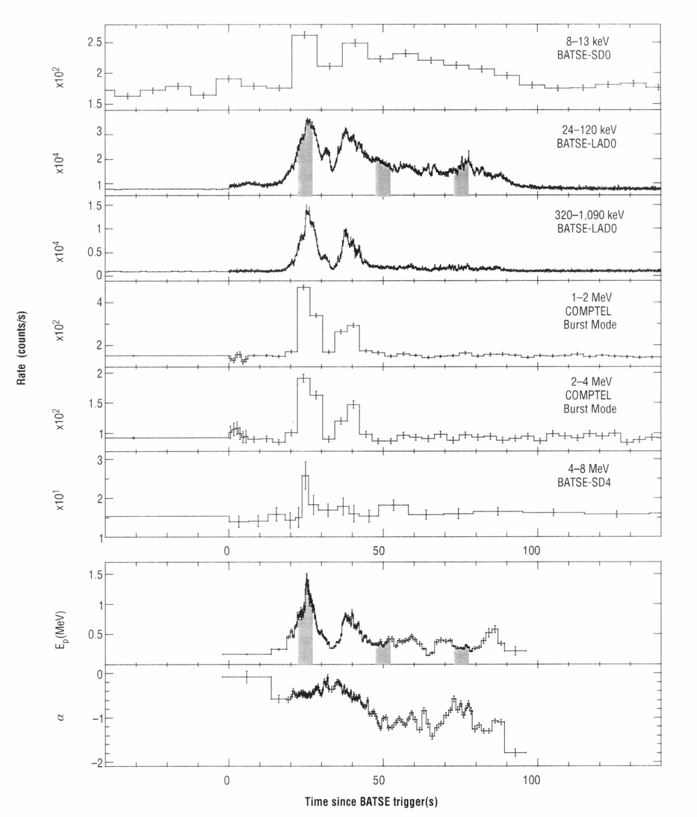
BACK to the analysis of CGRO database:
High energy precursors?
GRB990123
0 50 100
time, s

Slide 24
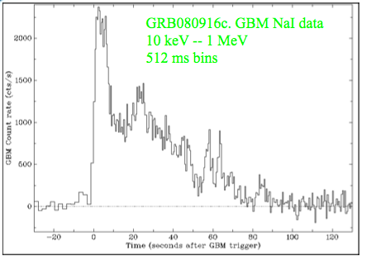
HE emission over duration of GBM GRB
10 photons with E>1 GeV, 3 with E>10 GeV
Fading source (firstly 21.7^{m}) at 32 hours after burst trigger
z~4.5

Slide 25
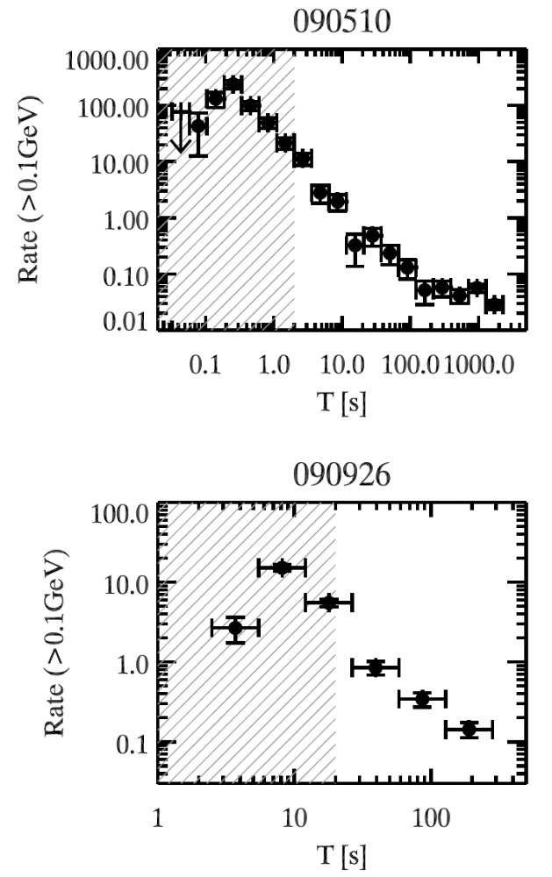
Extended high energy emission up to some hundreds of seconds observed during GRB090510and 090926 by LAT Fermi
(Ghisellini et al, 2010) i
The duration of the extended component some tens time
longer than duration of bursts. (Granot et al, 2010)

Slide 26
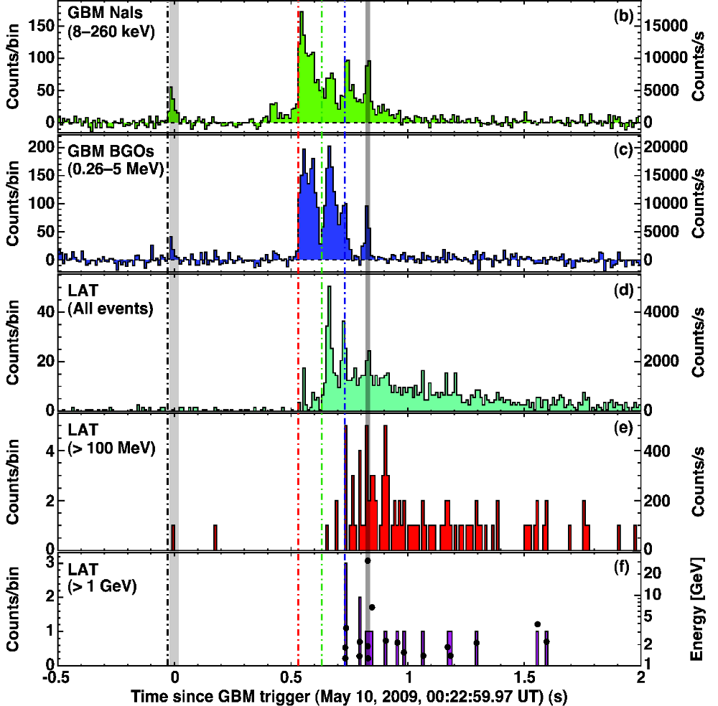
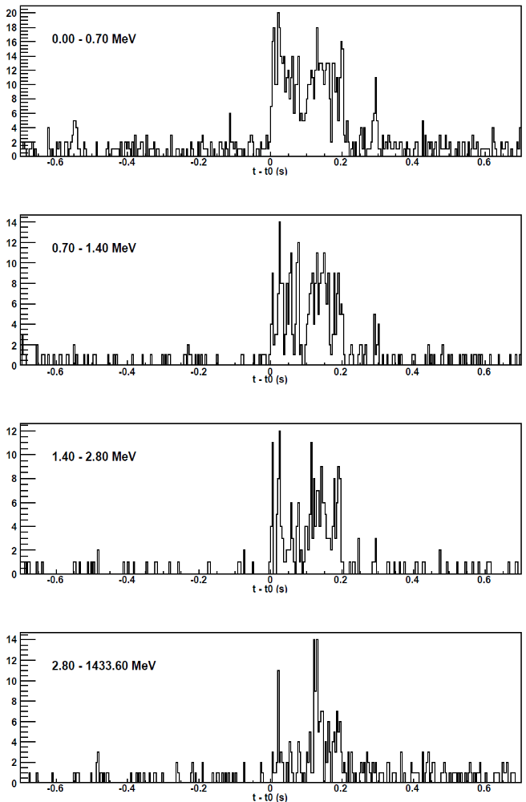
GRB 090510 (short burst): observations by Fermi and AGILE
precursor in wide energy band?

Slide 27
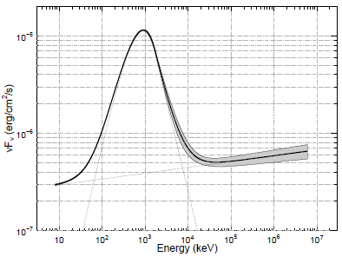
The highest energy of photons was registered during 090902B E ~33 GeV (Granot et al, 2010)
Extension of HE component to low
energy region down to tens keV?

Slide 28
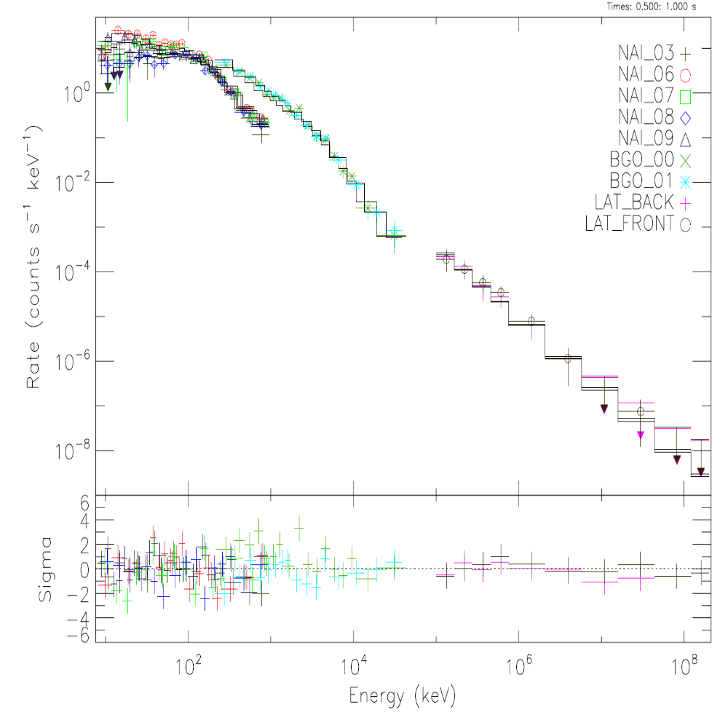

Slide 29
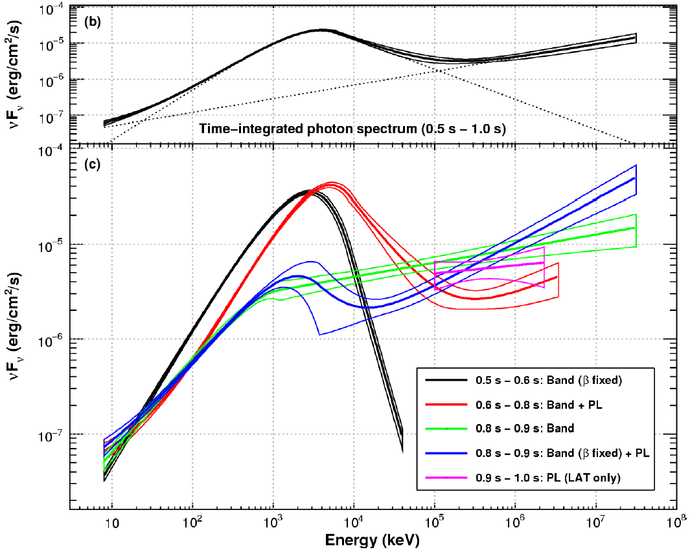
energy spectra of GRB090510 on Fermi data (Abdo et al, 2010)
E_{break} changes during burst (300 MeV → 10 MeV)

Slide 30
PRESENT TIME → satellite experiments Fermi and AGILE.
all properties founded during CGRO and AVS-F database analysis
Additional HE component in GRB spectra
Extension of HE component to low energy region down to tens keV?
The sources of GRB with presence of high energy emission located at various distances: some has redshift less than 1 but for GRB080916C z~4.4
Both short and long GRB has extended emission
Precursors in wide energy band
High energy precursors

Slide 31
CONCLUSIONS
Both short and long GRB has prompt and extended HE emission
In some cases the temporal profiles of GRB in low and high energy bands are similar but in some cases they are different and maxima are not coincide (for example, GRB930131 and GRB 050525)
Spectra of some GRB has additional high energy component
Extension of HE component to low energy region down to tens keV
For some GRB the hard to soft spectral evolution is absent or weakly defined (GRB930506 and GRB050525)
During some GRB very high energy photons (up to 33 GeV) were observed in space experiments and up to some TeV in ground-based ones.
3 types of GRB precursors
No very high energy emission ( up to several hundred MeV ) during several GRB
Should be introduced additional spectral characteristic E_{break}
E_{break} from some MeV up to hundreds of MeV and changed during burst

Slide 32
Thank you for attention!

Slide 33
GLAST GRB detection (GCN circulars) now 14 GRB:
21 GRB and only 2 has high energy tails >2MeV
GRB t₉₀ ,s Epeak Emax
GRB080913B: 140 114keV
GRB080916C: 66 444keV >1GeV
GRB080916A: 60 109keV 1MeV
GRB080912 : 17 ? 1MeV
GRB080906B: 5 125keV 1MeV
GRB080905C: 11 78.8keV 1MeV
GRB080905B: 159(prec?) ? 1MeV
GRB080905A: 1 ? 300keV
GRB080904: 22 35keV(XRF?) 300keV
GRB080830: 45 154 keV >300keV
GRB080825C: 22 170keV >500 MeV
GRB080824: 28 100keV >300 keV
GRB080823: 46 165keV >300keV
GRB080818B : 10 80keV >300keV
GRB080818 : 50 ? 300keV
GRB080817B : 6 ? 1MeV
GRB080817 : 70 ? ?
GRB080816B : 5 1230keV 3500keV
GRB080816 : 70 147 keV 500keV
GRB080812 : 15 140keV ?
GRB080810 : >120 314keV ?

Slide 34
GRB with high energy tails: mostly long up to now – tendency or
easy to detect?
GRB | t₉₀,s | E_{max,} MeV | no-Band component | z | Difference in time profiles
910503 | 50.816 | 200 | + | - | -
920622 | 35.968 | 10 | - | - | -
930131 | 19.2 | 30 | - | - | +
930506 | 22.144 | 167 | + | - | -
940217 | 150.144 | 18000 | - | - | + (HE tail till to 1.5h)
940301 | 42.496 | 160 | - | - | -
940703 | 34.88 | 139 | + | - | -
940921 | 39.936 | 178 | - | - | -
941017 | 77.056 | 200 | + | - | + (extended HE emission)
970202 | 26.688 | 100 | + | - | -
990104 | 18.944 | 210 | - | - | - (precursor)
990123 | 63.360 | 128 | ? | 1.60 | + hard precursor?
021008 | 12(l)/8(h) | 25 | - | - | -
050525C | 20(l)/24(h) | 150 | - | - | +
080514B | 10 | >1000 | ? | ? | + hard precursor?
080528 | 0.25 | >10? | ? | - | Detection in 2.8-1433.5MeV
080825C | 23 | >300 | + | ? | HE emission only after 35s
080916C | 66 | >1000 | ? | ? | -

Slide 35
Types of
GRB with high energy tails
Band spectra presence of no-Band
? component
component with E>500MeV
similar temporal
profiles in various
energy regions
extended HE emission
different behavior
of temporal profiles
in various energy regions
no hard to soft evolution
high energy precursors?
low energy precursors
precursors in wide energy band

Slide 36
Conclusions
Some GRB with presence of high energy component (more than some MeV) within BATSE t₉₀ intervals were detected by other experiments onboard CGRO and later such component within RHESSI, HETE and SWIFT ones were detected by AVS-F apparatus (CORONAS-F satellite) Agile and GLAST too.
In some cases the temporal profiles of GRB in low and high energy bands are similar but in some cases they are different and maxima are not coincide (for example, GRB930131 and GRB 050525)
Spectra of some GRB has high energy component which contradict Band model. Moreover, for some such GRB the hard to soft spectral evolution is absent or weakly defined – for example, for GRB930506 and for GRB050525.
Unfortunately redshift is known only for RB990123 (z=1.60) .
During some GRB very high energy photons (up to 18 GeV were observed in space experiments and up to some TeV in ground-based ones.

Slide 37
GLAST: Fermi GBM & LAT
The GLAST Burst Monitor includes 12 Sodium Iodide (NaI) scintillation detectors and 2 Bismuth Germanate (BGO) scintillation detectors. The NaI detectors cover the lower part of the energy range, from a few keV to about 1 MeV and provide burst triggers and locations. The BGO detectors cover the energy range of ~150 keV to ~30 MeV
GLAST Large Area Telescope will consist of four main components.
Precision Tracker
Calorimeter
Data Acquisition System
Anticoincidence Detector (segmented plastic scintillator tiles)
LAT baseline design for the GLAST tracker consists of a four-by-four array of tower modules. Each tower module consists of interleaved planes of silicon-strip detectors and tungsten converter sheets. Silicon-strip detectors are able to more precisely track the electron or positron produced from the initial gamma-ray than previous types of detectors. SSDs will have the ability to determine the location of an object in the sky to within 0.5 to 5 arc minutes.
Calorimeter consist of CsI(Tl) bars, arranged in a segmented manner, give both longitudinal and transverse information about the energy deposition pattern.

Slide 39
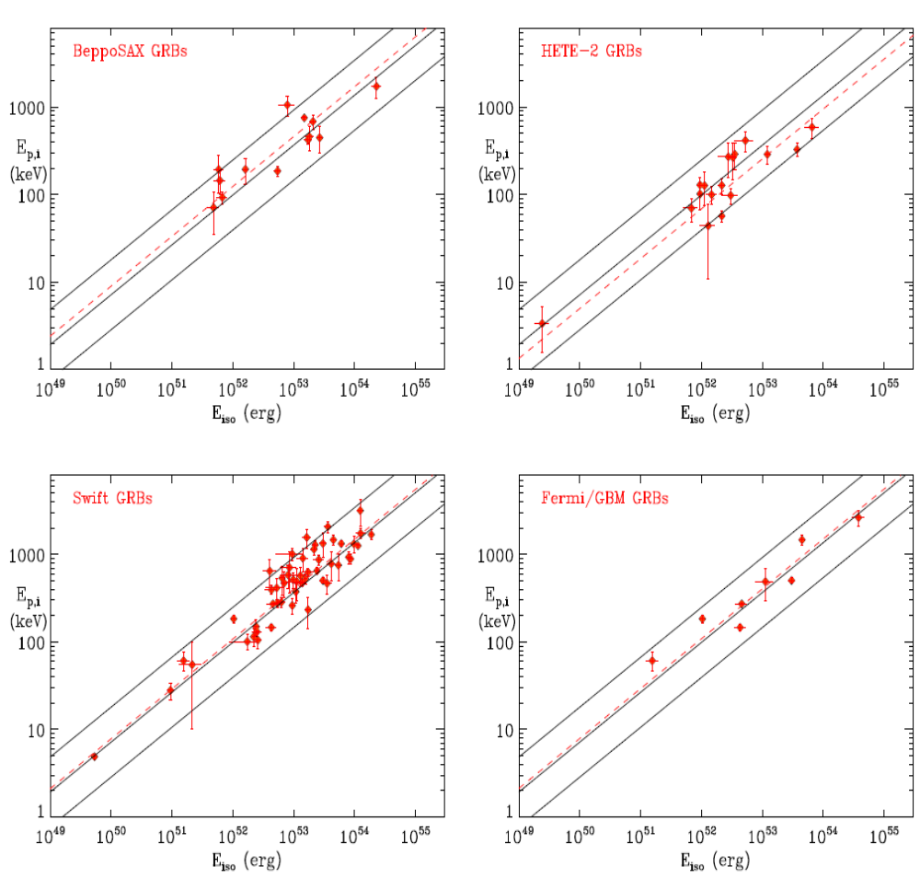
Amati et al, July 13, 2010

