Slide 1
The application of the BrilLanCe series scintillation
detector in the spectrometer of neutral particles for
the satellite experiment ZINA-NT
Arkhangelskaja I.V., Arkhangelsky A.I., Batischev, A.G.,
Galper A.M., Kondratyeva N.V., Naumov P. Yu.
National Nuclear University “MEPhI”

Slide 2
THE EXPERIMENT GOALS & TASKS
Studying of GRB X-ray and γ-emission included HE up to 300 MeV
Detailed investigation of GRB spectra in wide energy band
Space weather monitoring
Magnetospheric particles flows monitoring
Studying flows of charged particles and n during solar flares
Investigation of X-ray and γ-emission during solar flares (including 15.11 MeV and 20.58 MeV lines)
Investigation of X-ray and γ-emission of TGF

Slide 3
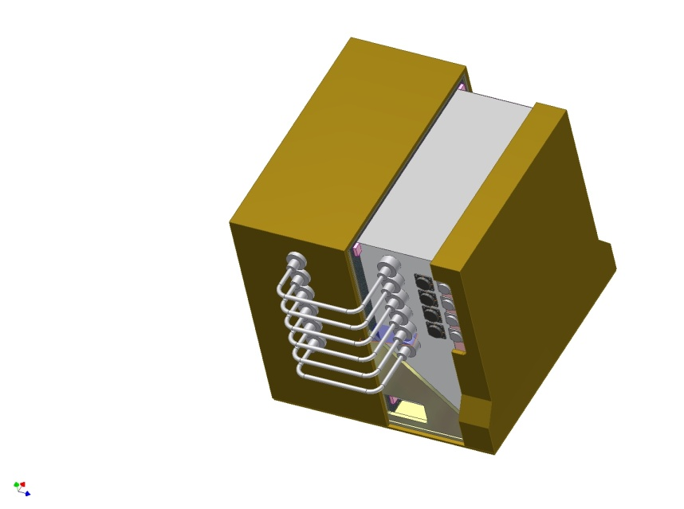
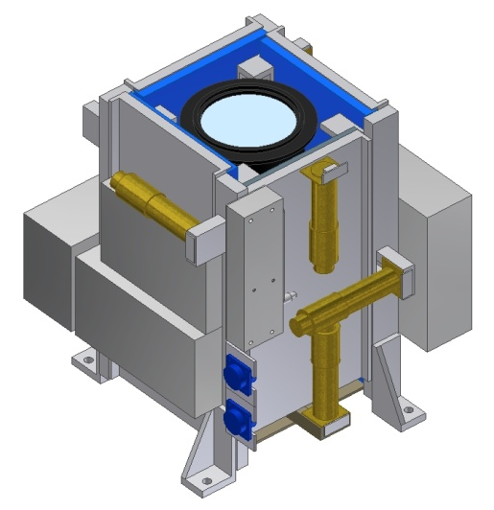
ZINA-NT experiment detectors
Multilayer scintillator detector (МSD) – NRNU “MEPhI”, Russia;
Detector of neutral particle (DNP) – NRNU “MEPhI”, Russia;
Processor System – Physics Institute of NAS of Belorussia.
MSD detector
DNP detector

Slide 4
Parameters of МSD
Energy bands:
Electrons and positrons 4 - 25 MeV
Protons and He nuclei 40 - 110 MeV/nucleon
Energy resolution:
Protons and He nuclei 1,5 - 4%
Electrons 6 - 8%
geometric quotient 40 cm²*sr
aperture 80 º
Time resolution 100 ns

Slide 5
The function diagram of ZINA-NT detector
polystyrene
PMT
PMT
PMT
scintillator
crystal
C 11
scintillator
crystal
PMT
PMT
C 12 – 3
top view
front view
PMT
PMT
TRIGGER: МSТ=(АС) × С11,
АС=(С14 OR С13 OR С12-1 OR С12-2 OR С12-3 OR С12-4)
Back current→ timing analysis Δt (C11-AC)>0.5ns
(if fast scintillator used)

Slide 6
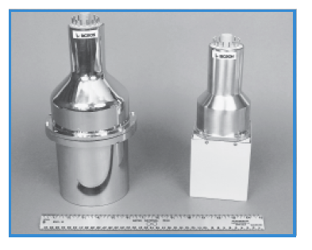
Scintillator class BrilLanCe – used firstly in Delft University (Netherland)
Produced by: SAINT GOBAIN CERAMICS & PLASTICS
BrilLanCe350
LaCl₃:Ce (10%Сe)
BrilLanCe380
LaBr₃:Ce (5%Сe)

Slide 7
Main characteristics of NaI(Tl), CsI(Tl) & BrilLanCe crystals
( all has at least two lightoutput components)
Characteristics | NaI(Tl) | CsI(Tl) | LaBr₃:Ce | LaCl₃:Ce
Light output , quanta/кeV | 38 | 45 | 65 | 48
Fast time (tf), ns | 220 | 700 | 18 | 25
Slow time (ts), μs | 1,4 | 2-5 | 0,8 unstable | 0,5
Relation between components(C1\C2) at 25^{о}С, % | 85:15 | 50:450 | 90:10 | 80:20
fluorescence from HE charged particles | weakly | Up to 20 ms | weakly | weakly
Density, g/sм³ | 3,67 | 4,51 | 5,08 | 3,85
λ, nm ( at light maximum) | 410 | 565 | 380 | 350
Mechanical stress res. | low | high | high | high
Energy resolution (662 кeV) | 7% | 9% | 2,9% | 3,8%
Water resistance | yes | no | weakly | weakly (at high Tº)
Radiation hardness, rad | 10⁵ | 10⁷ | 1,5x10⁷ | 10⁷

Slide 8
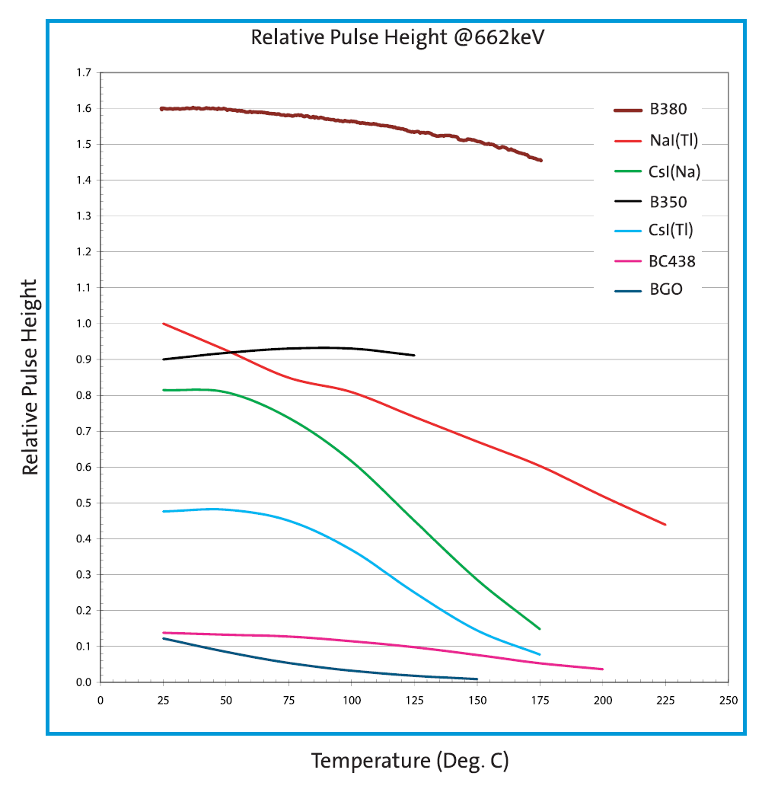
The temperature dependence of relative pulse height
relative pulse height

Slide 9
Pulse shape in CsI(Tl) crystal

Slide 10
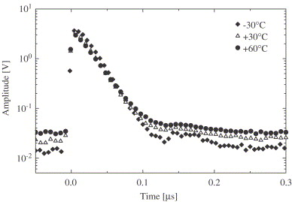
Pulse shape in LaBr₃:Ce crystal
The slow component is unstable- identification on base of fast component

Slide 11
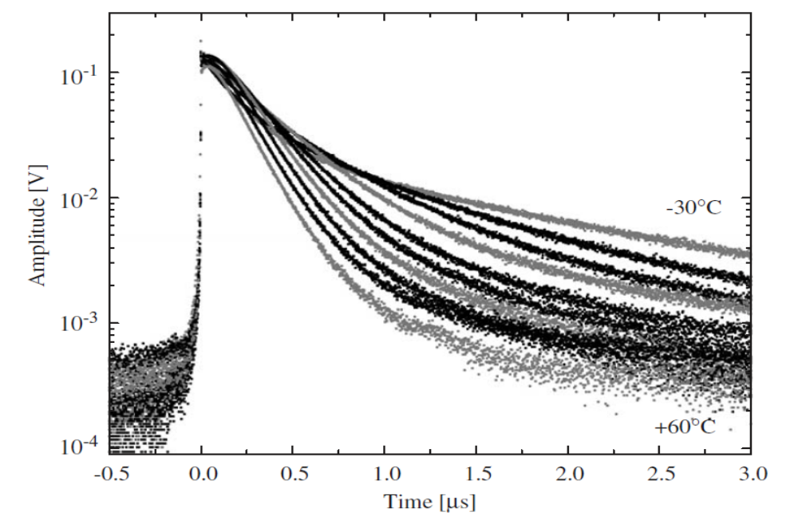
Pulse shape in NaI(Tl) crystal
very strong temperature dependence!

Slide 12
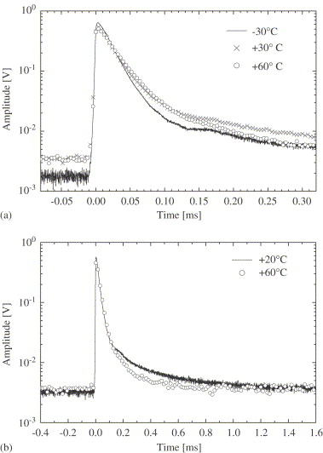
Pulse shape in LaCl₃:Ce crystal

Slide 13
A some light components in scintillators
CsI(Tl) t1~0.4-0.7μs t2~7μs | A particle with different ionizing capability can be sorting by the pulse shape analyzing method
LaCl₃:Ce t1~25 ns t2~0,5μs
LaBr₃:Ce t1~20 ns t2~0,8μs (unstable)

Slide 14
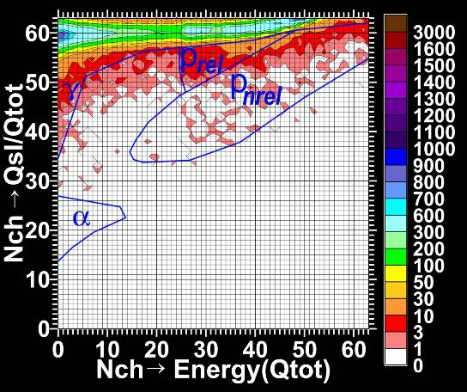
The ratio Qslow/Qtot in dependence of energy in CsI(Tl)

Slide 15
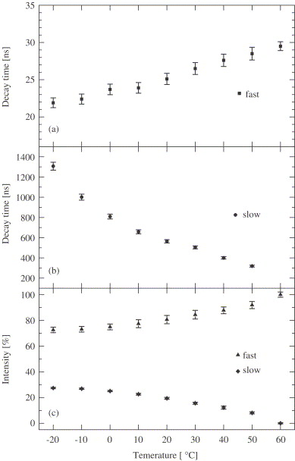
The fast and slow light component temperature dependence for the LaCl₃:Ce crystal

Slide 16
Relative light intensity (fast and slow component) vs temperature for scintillator LaCl₃:Ce

Slide 17
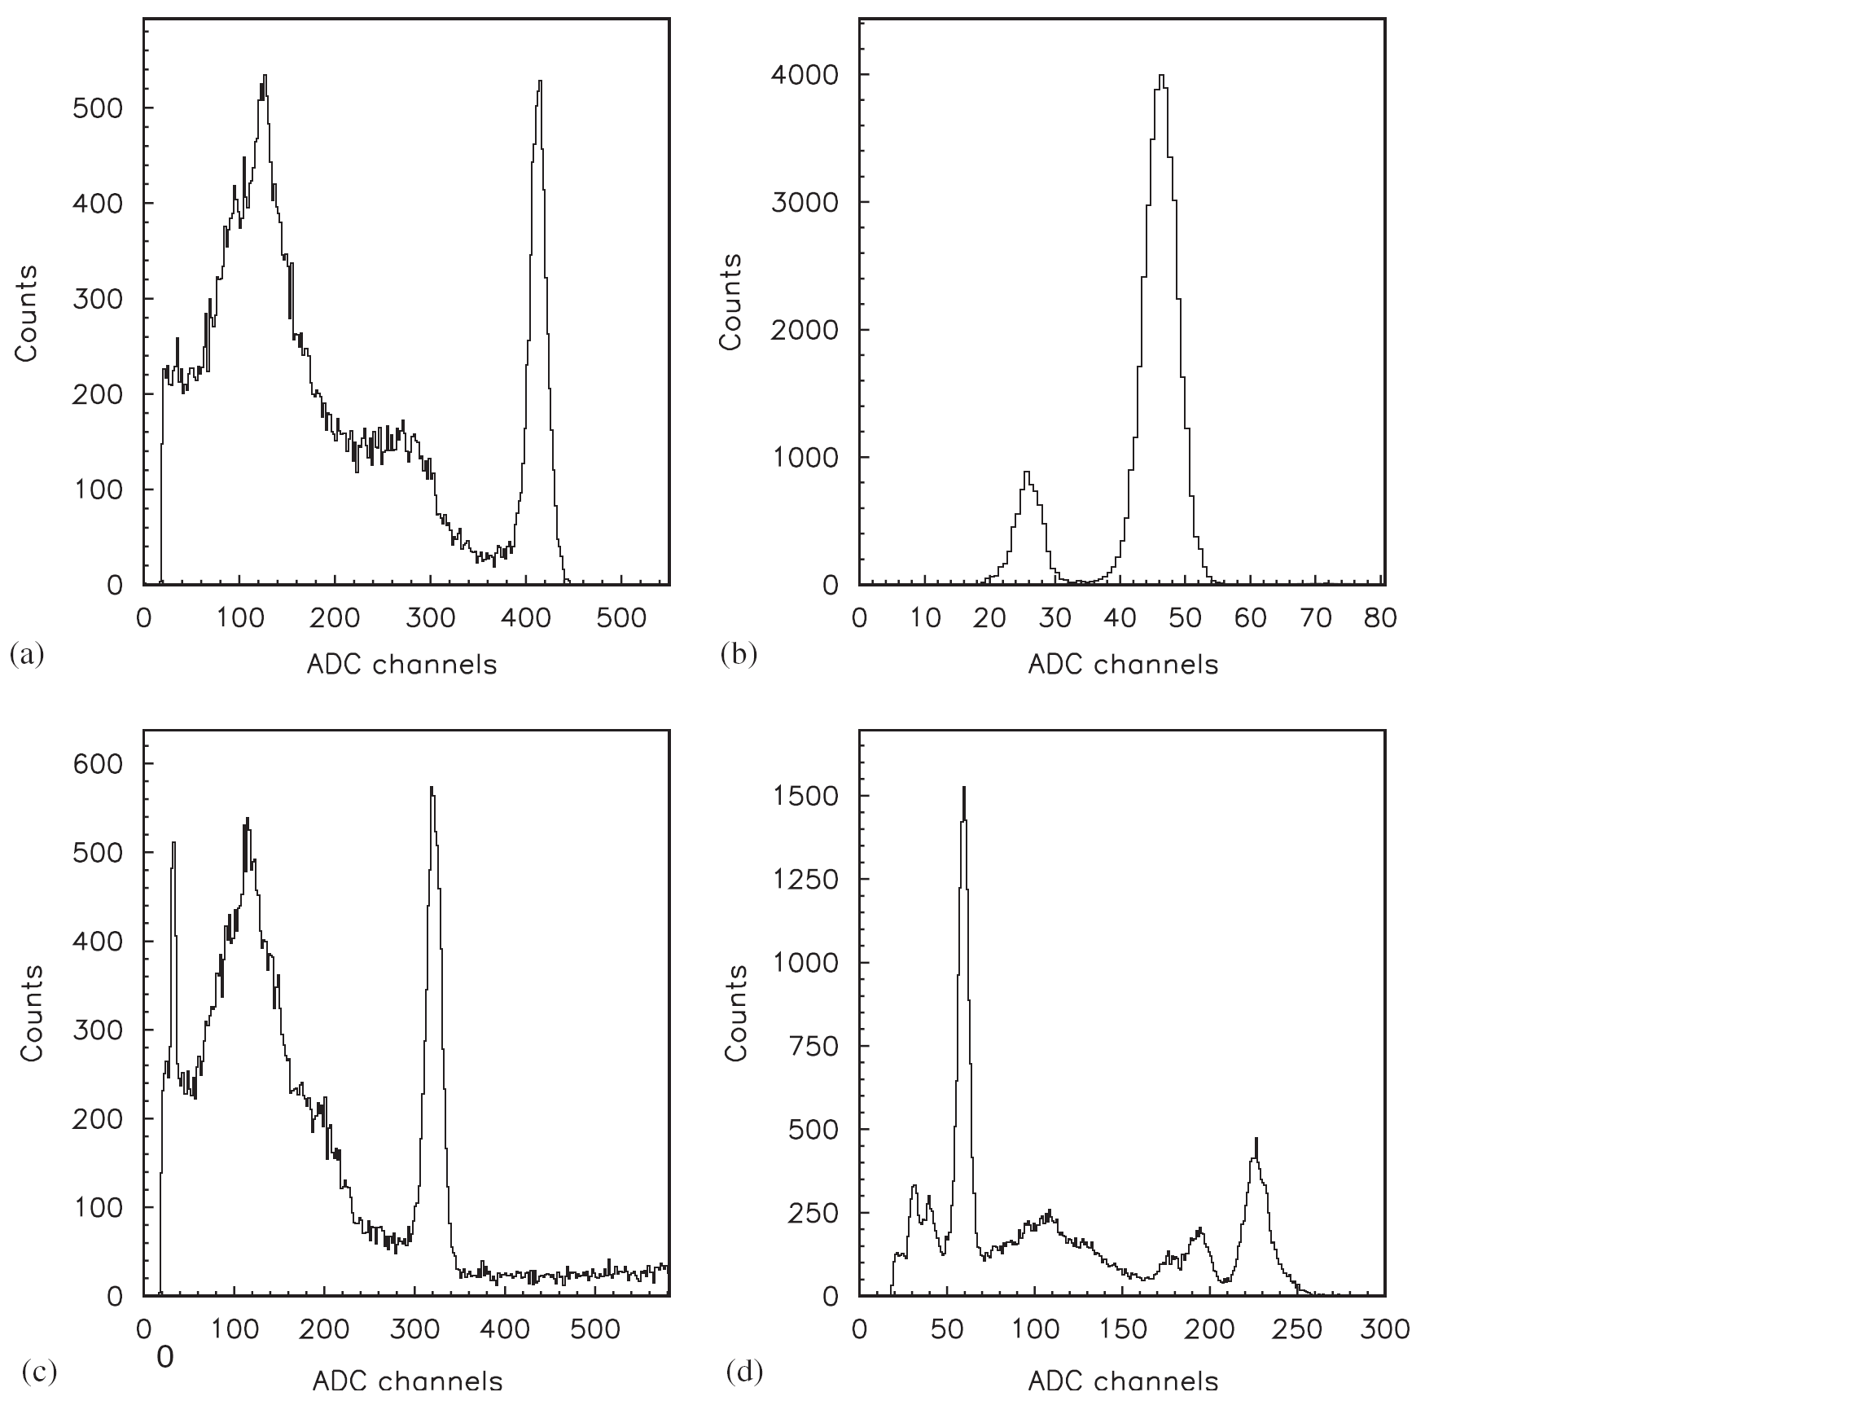
3”x 3” crystal + PMT EMI9265-B53/FL
¹³⁷Am → 20%
(59,5 keV)
¹³⁷Cs → 5.4%
(662 keV)
ADC channel
ADC channel

Slide 18
3”x3” crystal + PMT EMI9265-B53/FL
²²Na → 6%
(511 keV)
¹³³Ba → 16%
(87 кeV)
¹³³Ba → 7%
(356 кeV)
ADC channel
ADC channel

Slide 19
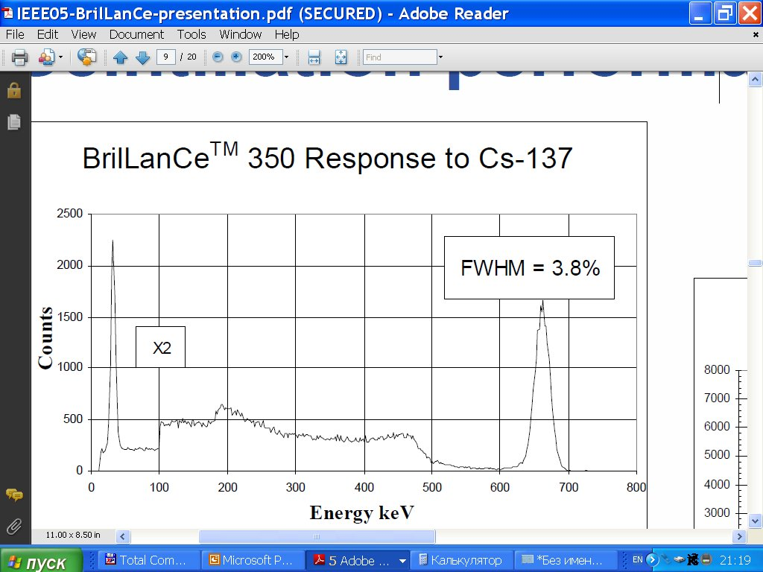

Slide 20
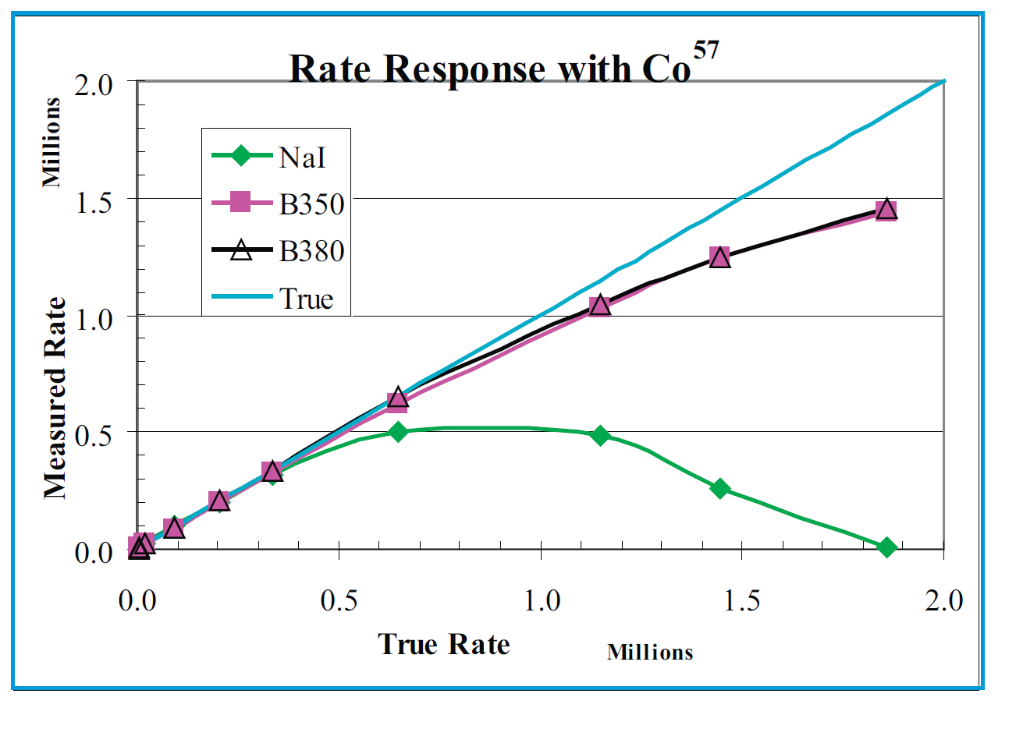
wide region of linearity of BrilLanCe series crystals!

Slide 21
3 possible opportunities of DNP
in ZINA-NT experiment
6’ x 6’ CsI(Tl)
  energy band 100 keV-300MeV (γ-quanta)
  min time resolution ~ 1 ms
  problem with high intensity events
6’’ x 6’’ NaI(Tl)-CsI(Tl)
  energy band 50 keV-300MeV (γ-quanta)
  min time resolution ~ 1 ms
  reduced fluorescence from HE charged particles
  min time resolution ~ 1 ms
  problem with high intensity events
6’’ x 6’’ BrilLanCe350 (LaCl₃:Ce (10%Сe))

Slide 22
CONCLUSIONS: BrilLanCe series crystal in DNP instead of CsI(Tl):
energy resolution is better ( the factor of 2-3 )
⇒low limit of detector energy band ~20 keV instead of 100 keV;
temperature stability is better;
lightoutput components are faster (the factor of the order) :
⇒ time resolution: ~5 μs (instead of 1ms) for γ up to 20 MeV,
~15μs(instead of 10ms)for events need analysis of pulse shape(HEγ and n);
⇒ several parallel timescales: μs (instead of ms),1s,10s,64s and 128s for events with low statistic (15.11 and 20.58 MeV nuclear lines in solar flares,
GRB extended emission and so on);
⇒ registration of more intensive fluxes;
⇒ possibility of remove ~90% of back current!!
pulse shape discrimination require additional analysis;
self radioactivity caused by 0.09% of ¹³⁸La and mixture of ²⁷Ac;
very fast ADC and special electronics.
positive
negative

Slide 23
ZINA-NT will be installed
onboard ISS at 2015
Now this project is open for collaboration!
Special thanks to prof. W.Q. Gan from PMO (China) for very useful discussion

Slide 24
Thank you for attention!

