Slide 1







The MIRAX mission
João Braga - INPE

Slide 2
MIRAX mission
First Brazilian-led astronomical satellite project
High-energy astrophysics observational window for the Brazilian community
International collaboration ⇒ expertise in space missions and cost sharing
Strong participation of Brazilian institutions and industry
public data in MIRAX mission centers, NASA HEASARC archive and others

Slide 3
MIRAX brief history
May 2000: Selected by INPE’s Astrophysics Division
to be part of INPE’s scientific satellite program
2000: Collaboration with CASS/UCSD:
crossed-strip CdZnTe detectors
2001: Collaboration with IAA/Tübingen: onboard computer
and software development
2001: Collaboration with MIT: science and software for
data analysis, archiving and distribution
2001: First presentation at Brazilian Astronomical Society
(SAB) meeting - open to community participation
2002: - Approved by AEB (Brazilian Space Agency)
- First workshop held at INPE S.J.Campos
2004: HXI detailed design and simulations start

Slide 4
MIRAX brief history
2005: - Included explicitly at Brazilian National Plan for
Space Activities
- Second workshop held at INPE – AIP proceedings
book
2007: Decision to put MIRAX onboard Lattes (alongside
EQUARS – atmosphere, aeronomy mission)
2008: protoMIRAX balloon project started; UCSD CZT
detectors phased-out due to lack of NASA funding
2009: initial contacts about a possible collaboration with
Un. Ferrara - Prof. Filippo Frontera - and INAF –
Marco Feroci and Lorenzo Amati: soft X-ray and
gamma-ray instruments for GRB science:
2010: meeting in Brazil with Italian researchers and
engineers; ICRANet support – Prof. Remo Ruffini

Slide 5
MIRAX baseline parameters
Mission and spacecraft parameters
Mass | ~500 kg (PMM total), ~120 kg (MIRAX payload)
Power | ~240 W (total), ~100 W (MIRAX payload)
Orbit | Near equatorial (15 º ) , circular, ~600 km, 4 years
Telemetry | Telemetry: X-band, ~2-3 Mbps TBD
Launch | not earlier than 2015; launcher to be selected
Instrument parameters | Hard X-ray Imager (HXI) - INPE | GRBM (preliminary) INAF/Un. Ferrara
Energy range | 10-200 keV | 2 keV – > 1 MeV
Angular Resolution | < 1º TBD | 4 arcmin
Detector type | 2mm-thick CZT array | Silicon drift chamber/CsI
Spectral resolution | < 5 kev @ 60 keV (FWHM) | ~1 keV @ 60 keV
Localization | < ~ 10 arcmin (10 σ) – TBD | < ~ 1 arcmin (10 σ)
Field-of-view | 20º x 20º FWHM – TBD | 2 sr
Sensitivity | ~ 10 mCrab (1 day, 5 σ) | < 5 mCrab (1 day, 5 σ)

Slide 6
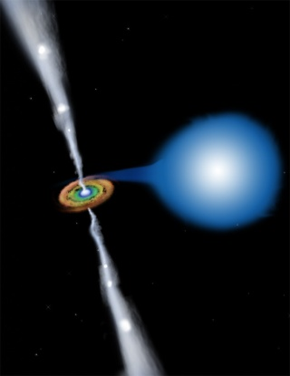
MIRAX SCIENCE
  Broadband imaging spectroscopy
  of a large source sample
  ⇓
Observation of many transient phenomena on X-ray sources
Detailed characterization of X-ray non-thermal emission
Wide-band spectra of GRBs (~ 5/month) and XRFs
Spectral state transitions and evolution on accreting compact objects
X-ray bursts – superburst recurrence times and emergence of normal bursts
after superbursts
Accretion torques on neutron stars
⇒ accreting pulsars, pulse period evolution, ms-pulsar recurrent outbursts
Relativistic jets on microquasars and other systems
Flaring X-ray sources and fast transients (many INTEGRAL sources)
AGN variability (obscured AGNs)

Slide 7
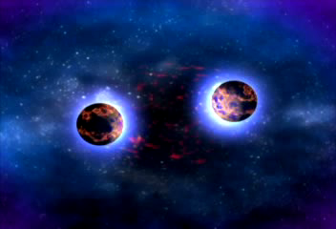

MIRAX Strategy
Unique capability to detect, localize, identify, and study many (2 sr) short-lived, rare, and/or unpredictable phenomena, including X-ray transient, GRBs and fast X-ray novae
Alert service for astronomers on all λs; coordinated optical/IR and radio observations to be planned

Slide 8

MIRAX instruments
1 hard X-ray imaging camera
built by DAS/INPE
20º x 20º FWHM Field-of-View
< 1º angular resolution - TBD
Energy range: 10-200 keV
CZT (Cd_{0.9}Zn_{0.1}Te) detectors
  1 cm spatial resolution (detector size)
  < 5 keV spectral resolution @ 60 keV
  169 (13 x13) detectors ⇒ 169 cm² total area

Slide 9
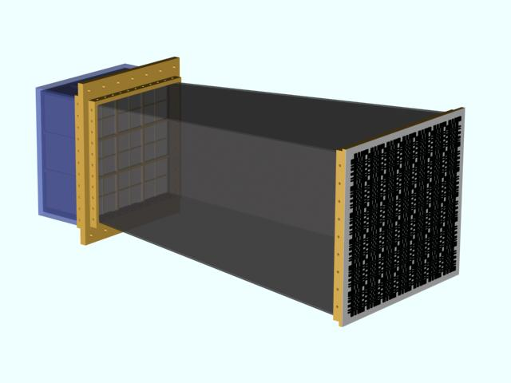
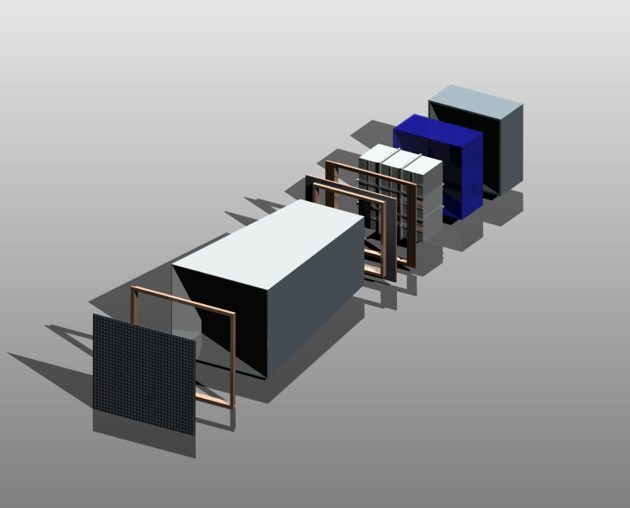
HXI concept
Plastic Scintilator
(6mm-thick)
drawings by L.A.Reitano
Pb-Sn-Cu shield
CZT detectors
support flanges
Pb-Sn-Cu shield
(2mm-0.5mm-0.1mm)
mask support flange
coded mask

Slide 10
MIRAX instruments
set of Italian instruments (next talk)
provided by INAF and University of Ferrara
~2 keV to a few MeV energy range
2 sr field-of-view (preliminary design)
4 arcmin angular resolution
thin Silicon drift chambers
  Detectors have 200 μm position resolution in one direction
  Two sets with one-dimensional coded-masks for x and y directions
CsI scintillators for gamma rays

Slide 11
Current or planned hard X-ray imaging missions
mission | Energy range (keV) | FOV | Angular resolution
ASM/RXTE | 2-10 | “4π sr” (3 x 6ºx90º FWHM) | 12’
GBM/Fermi(GLAST) | 8-30000 | 9.5 steradians | 5º
JEM-X/INTEGRAL | 5-35 | 4.8º diam. FCFOV | 3’
IBIS/INTEGRAL | 15-10000 | 9º x 9º FCFOV | 12’
BAT/SWIFT | 14-150 | 2 sr PCFOV | 17’
SUPER-AGILE | 10-40 | 107º X 68º | 6’
MIRAX | 2-1000 | 2 sr FCFOV | 5’
excellent coverage of discovery space

Slide 12
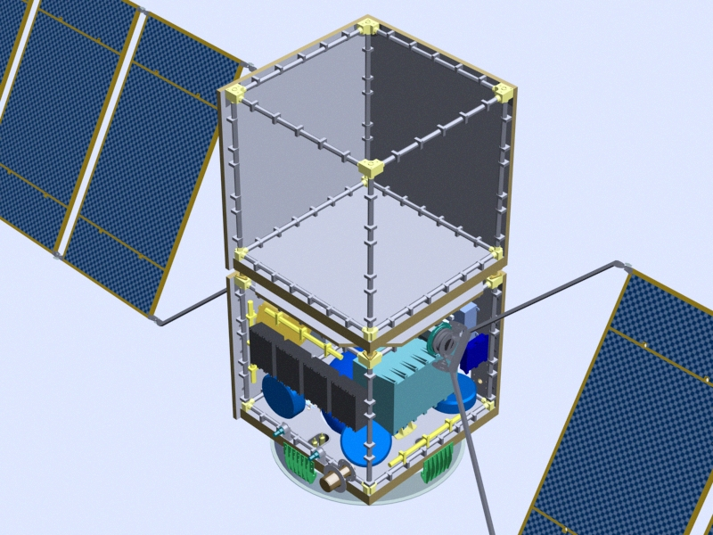
spacecraft concept
PMM – multimission platform

Slide 13
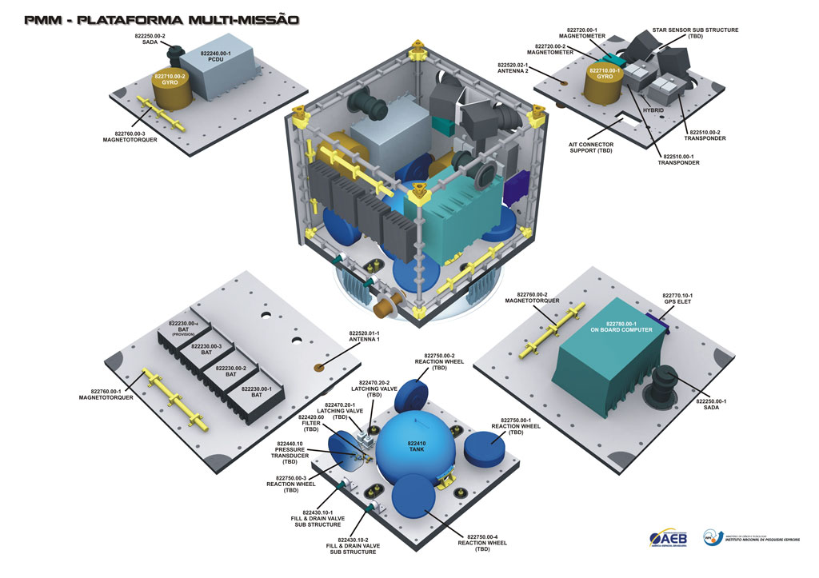
spacecraft concept

Slide 14
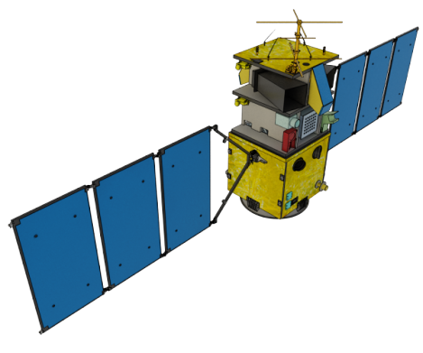
spacecraft concept
MIRAX

Slide 15
protoMIRAX
Test several MIRAX sub-systems in a near-space environment
Test imaging system and novel coded-mask techniques by looking at bright sources
Measure atmospheric background at SAA

Slide 16
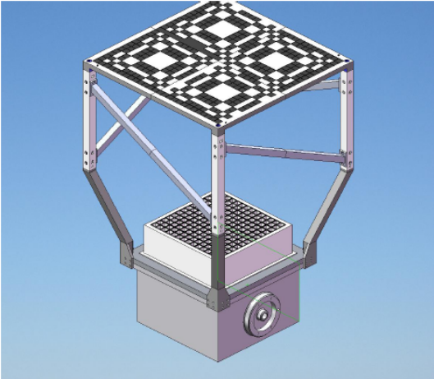
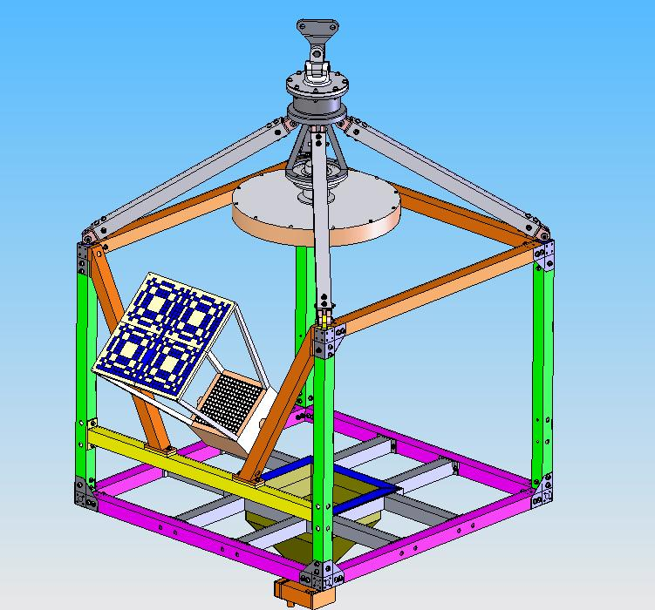
The protoMIRAX team
protoMIRAX camera
João Braga
Flavio D´Amico
Ricardo Varela
Valdivino Santiago
Fátima Mattiello
Jorge Mejia
Luiz A. Reitano
Barbara Rodrigues
Manuel Castro
protoMIRAX gondola

Slide 17
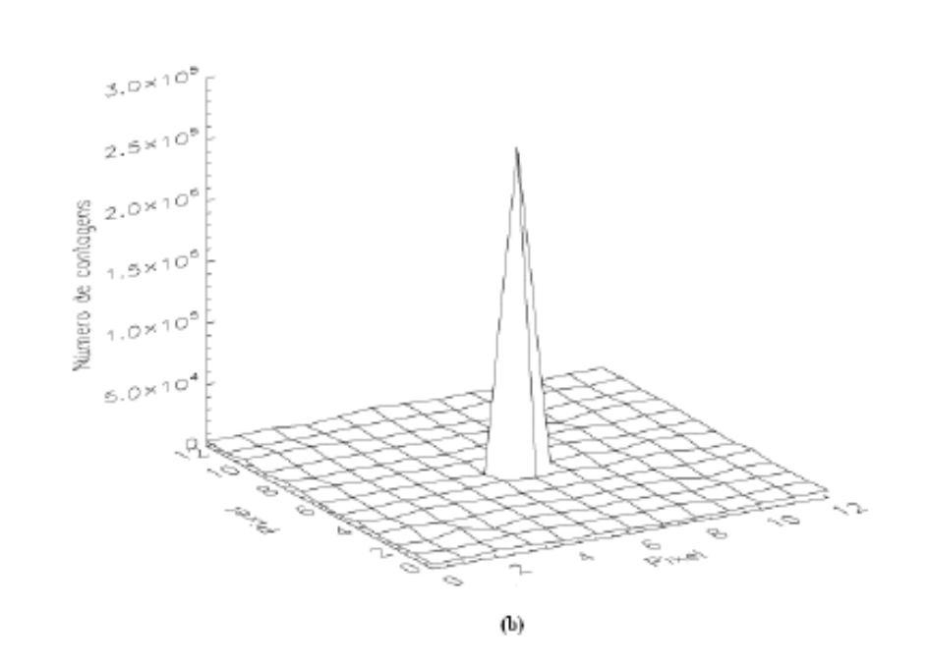
Crab simulations
GEANT simulated background and Crab hard X-ray spectrum ►Monte Carlo simulations of a Crab observation, 5.5 hs at -23º latitude (elevation angle variation taken into account)
SNR of ~250
Crab detected at 10σ level in 24 s

Slide 18
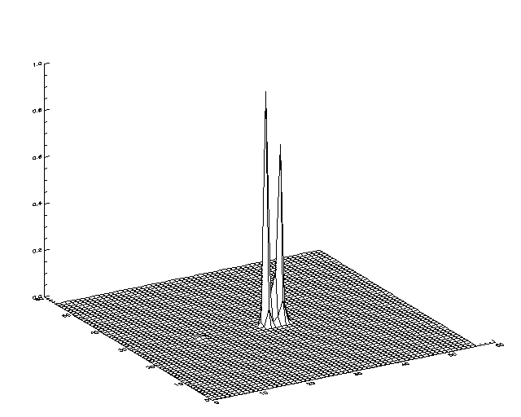
MIRAX simulations
Detailed background simulations using GEANT-based software for interactions (events recorded on the detectors) and maximum-likelihood iterative reconstruction algorithms:
Sub-pixel resolution technique:
Sources separated by 1º can be well determined, even though the detector pitch is 3 times larger that the mask element. (“normal” coded-mask resolution would be > 2º)

Slide 19
conclusions
MIRAX: a broadband X-ray/gamma-ray mission for GRB and transient sources
unique coverage of discovery space with ~arcmin resolution.
participation of Italian groups with state-of-the-art instruments will enhance science and provide GRB/XRF wideband spectra.
Launch in 2015; lifetime of 4 years minimum.

