Slide 1

Structure of Compact Stars with Dense Hadronic Matter at the Core
2nd Galileo-Xu Guangqi Conference, July 12- 16, Ventimglia, 2010
Hyun Kyu Lee
Hanyang University

Slide 2
I. Compact Stars
Stars (neutron stars, quark stars, ..)
~ solar mass and ~10km or less in size
Constituents of compact star
Hadrons responsible for mass of star
neutrons, protons, hyperons
pions, kaons, …….
Leptons
electrons, muons,
neutrinos(e-, mu-)
Exotics ?

Slide 3
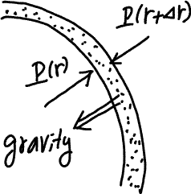
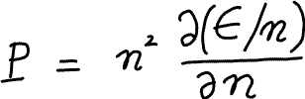
Stars and Gravity
Equation of state(EOS) of compact star
energy density and pressure
  TOV equation

Slide 4
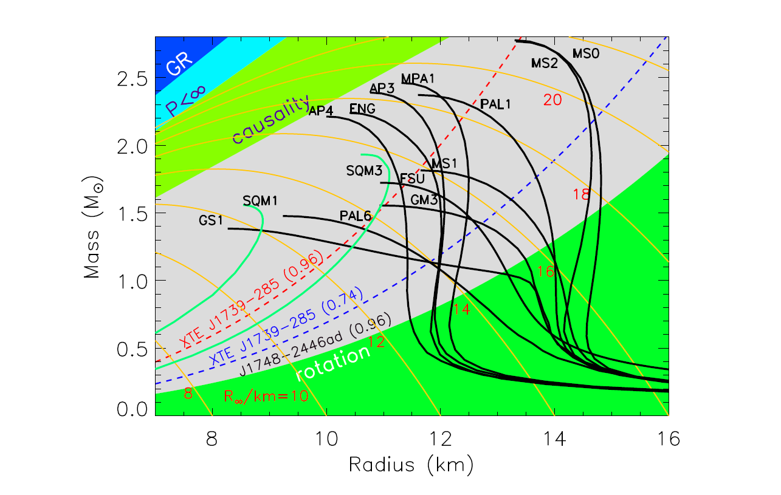
J.M. Lattimer and M. Prakash, Phys.Rept.442:109-165,2007

Slide 5
Higher nucleon number density inside
n =0 → n_0 → 6n_0 →
1. Change of nucleon-nucleon interaction with density
2. Emerging of new hadrons with density
kaons, hyperons(strange hadrons), ..
Change of EOS with density
→Dense Hadronic Matter at the Core !!

Slide 6
II. Hadronic Interactions
Fermi pressure of nucleons only cannot support the neutron star mass ~ solar mass
Nucleon-nucleon repulsion other than Pauli principle is needed at least
N-N interaction is known only upto nuclear density, n_0 = 0.16 fm⁻³
Energy density of nucleon matter:
free part(mass) + interaction part

Slide 7
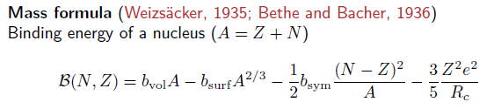



Heavier nuclei
Dense nuclear matter
n > n_0, ?????
Lattice QCD, Effective Theory for Hadrons,

Slide 8
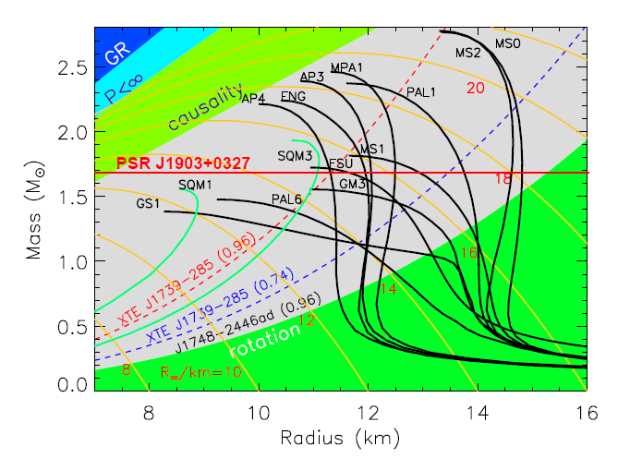

Slide 9
III. Nuclear Symmetry Energy
Measure of n-p asymmetry in nuclear interaction
In nuclear matter

Slide 10


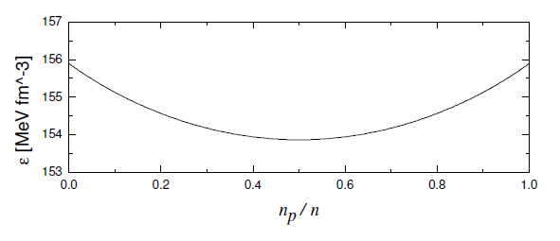

Non-interacting n-p system

Slide 11
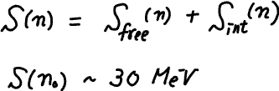
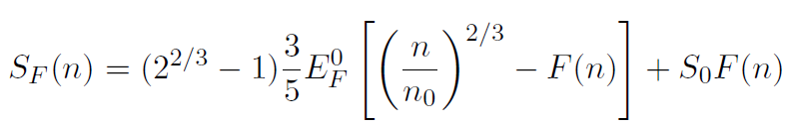
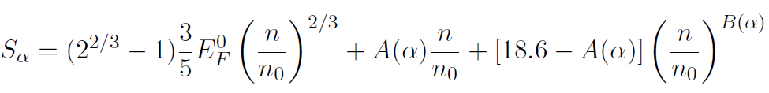
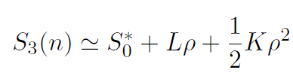
Nuclear interactions
Phenomenological forms of symmetry energy

Slide 12
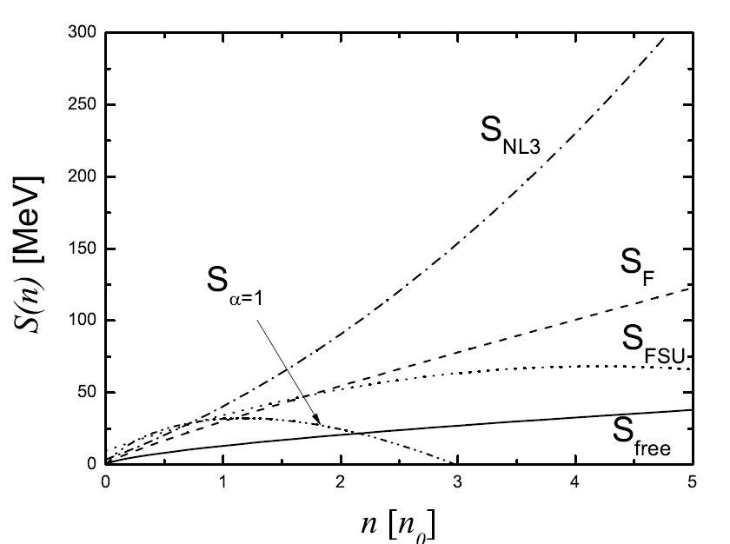

Slide 13

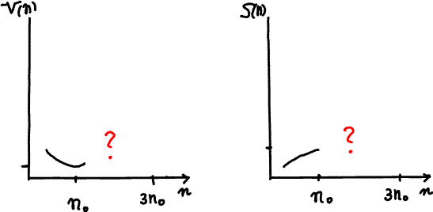
Up to nuclear density , n₀ = 0.16 fm⁻³
Compact star, n > n₀ with central density n_{center} > 3 n₀
Simple extrapolation of what are known at low density nuclear matter?

Slide 14
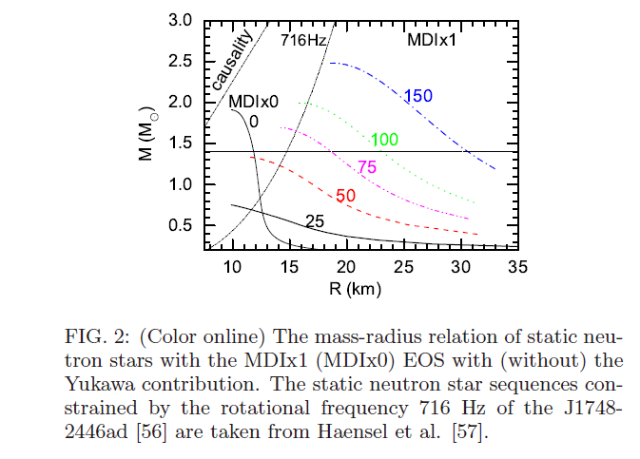

Slide 15
IV. Nuclear symmetry energy in compact stars
What is the role of symmetry energy(n-p asymmetry ) in compact star?
Symmetry energy provides a channel for new degrees of freedom in n-p system via weak interaction:
muon,
strange particles(kaon, hyperon) ,..

Slide 16




Symmetry energy and weak equilibrium in compact star
chemical potential of neutron and proton
beta equilibrium with electron
charge neutrality condition

Slide 17
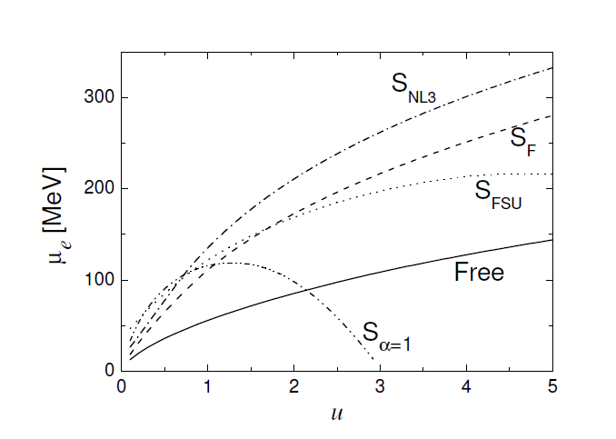

Slide 18


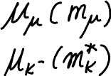
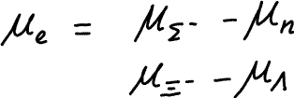
Strong interaction
Weak equilibrium with new degrees of freedom,
Kaon condensation, hyperon matter, ..

Slide 19



Hadron interaction at high density
Chiral perturbation theory
Tensor force with BR scaling
Thee body force
HLS
Skyrmion on the lattice
hQCD
…….

Slide 20
V. Possible structure with Strangeness
When the difference between chemical potentials of proton and neutron becomes comparable to kaon mass or hyperon mass in medium, the corresponding strange particles begin populating and the EOS get changed significantly.
Kaon condensation
Kaplan and Nelson,
Bethe and Brown,
Brown, Rho and Kubodera, …

Slide 21
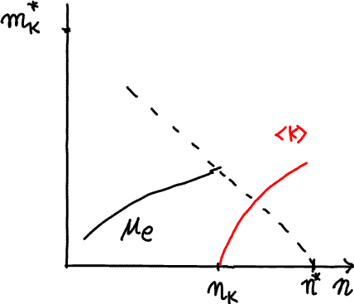
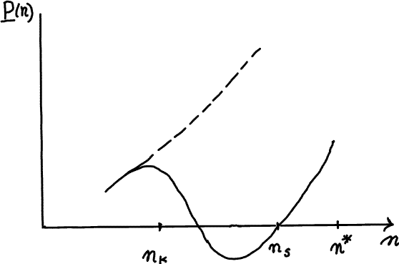
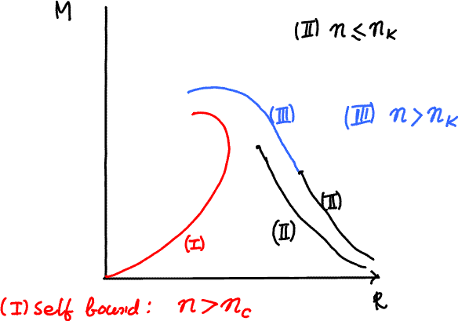
Stars with kaon condensed matter

Slide 22
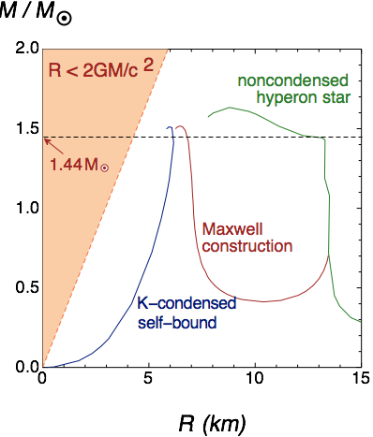
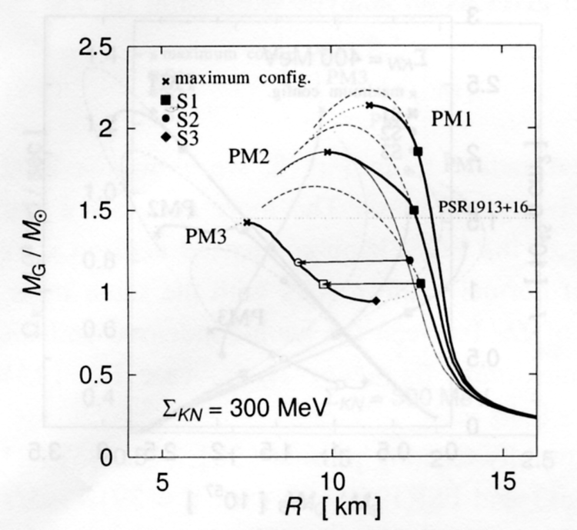
Muto et al.

Slide 23
Strange quark star with kaon-condensed surface (K. Kim, M. Rho and HKL in progress)
For a hadron system, where kaon chemical potential becomes much small about electron mass, there is no leptons to balance the positive charge of protons but kaons.
This is equivalent to strange quark matter with high enough density where strange quark mass can be neglected.
It can define the transition surface between hadronic phase with kaon condensation and strange quark matter

Slide 24
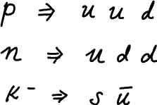
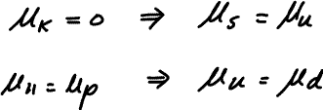
Quark Matter
Hadronic Matter
Kaon condensation
SQM

Slide 25
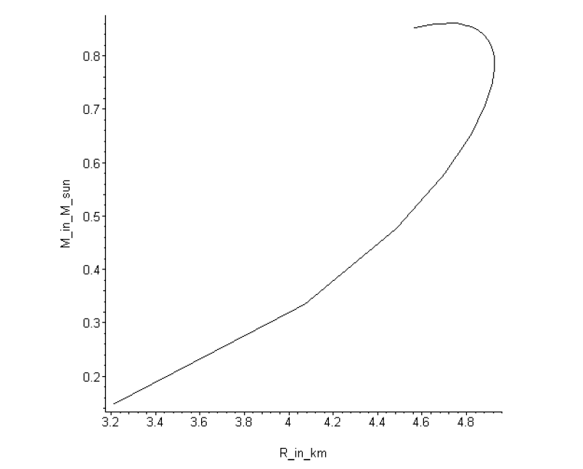
SQ star with self bound kaon surface
K.Kim, HKL, M.Rho, preliminary

Slide 26
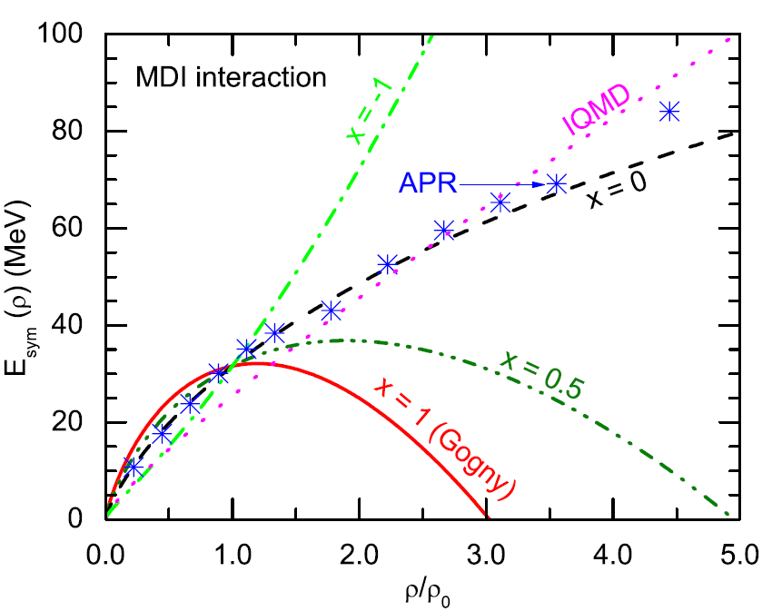
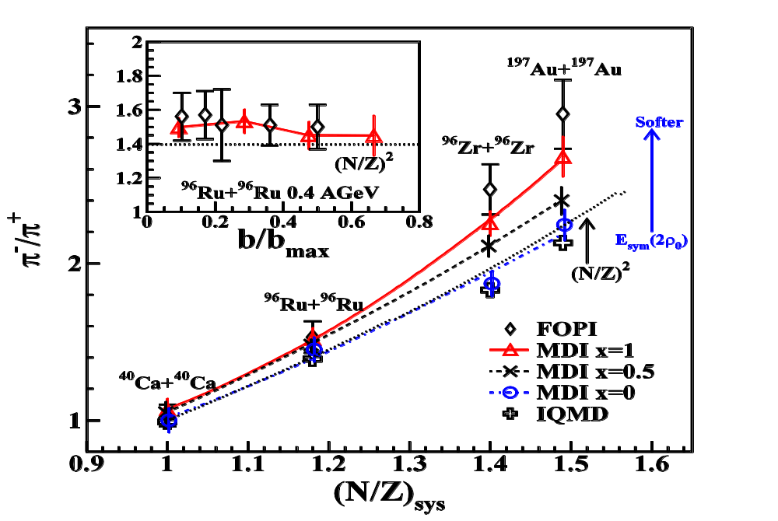
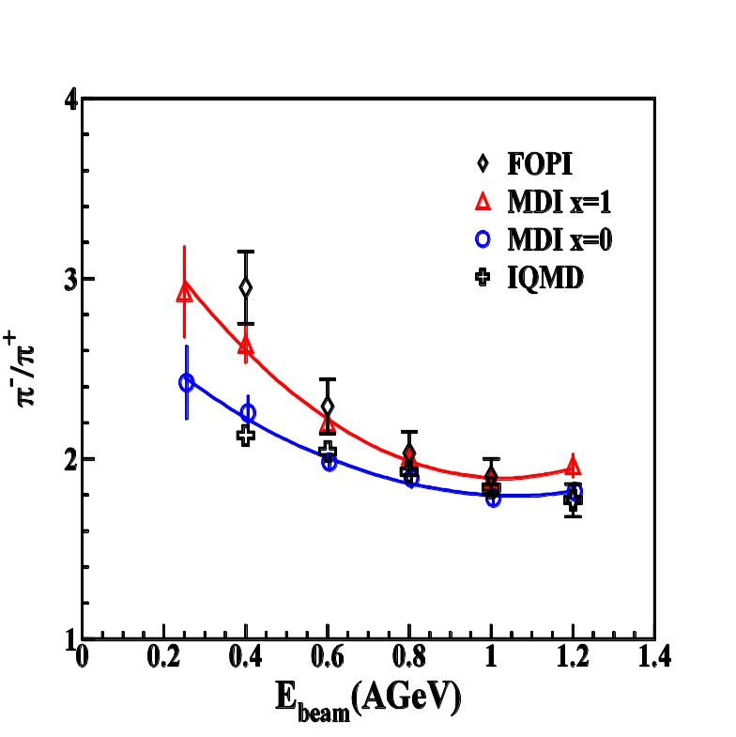
Supersoft symmetric energy
Transport model analysis using IBUU04
Z. Xiao, B.A. Li, L.W. Chen, G.C. Yong
and M. Zhang, PRL 102, 062502 (2009)
Au+Au
400 MeV/A

Slide 27
“Supersoft”is a disaster?
If Nature chose the “supersoft” E_{SS}
There could be NO stable neutron stars unless …!!
But Nature is full of neutron stars including
the Hulse-Taylor binary pulsar.
Drastic wayout by D.H. Wen et al, PRL 103, 211102 (09):
Modify Newtonian gravity, which could be emergent
(e.g., a la E. Verlinde, arXiv:1001.0785).
But kaons will not condense, and
make Bethe and Brown very unhappy

Slide 28
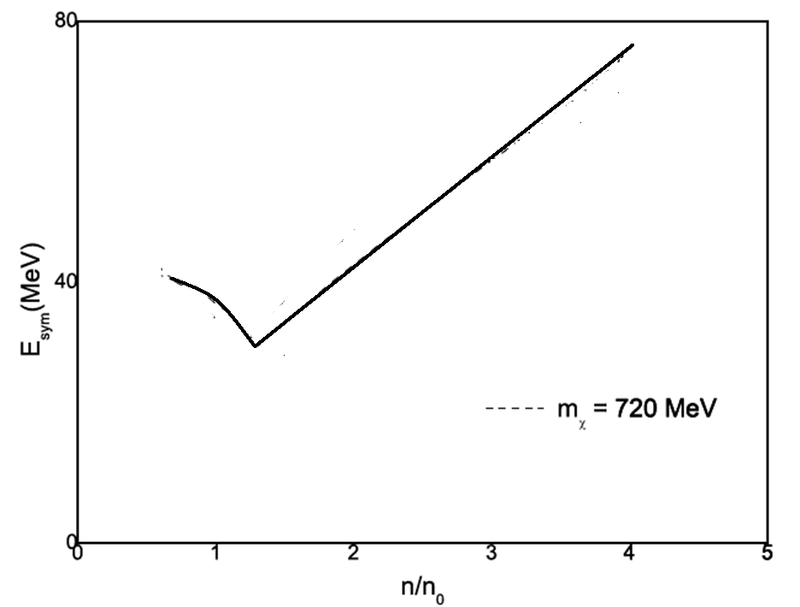
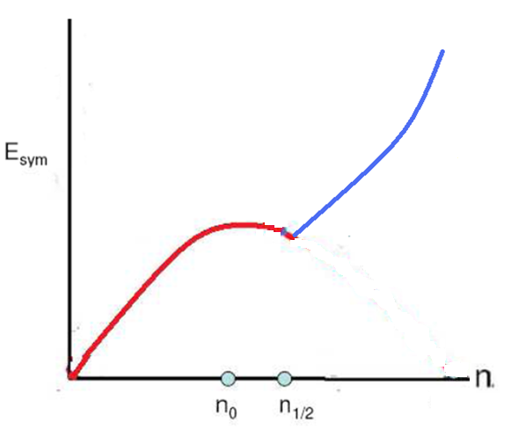
½-skyrmion vs. scaling
They agree
Half-skyrmion
Scaling prediction
This prediction could be checked or falsified at
FAIR or even RIB (e.g., KoRIA) machines
HKL, B.Y. Park, M.Rho, arXiv:1005.0255

Slide 29
Summary
Higher density, n > n₀ at the core of compact star
Symmetry energy (n-p asymmetry) opens new degrees of freedom into n-p system in weak equilibrium → New Structure
Emergence of strangeness at the core
kaon condensation, hyperon degrees of freedom
Mass, radius and compositions,....
Cooling, GW, GRB, …..

