Slide 1
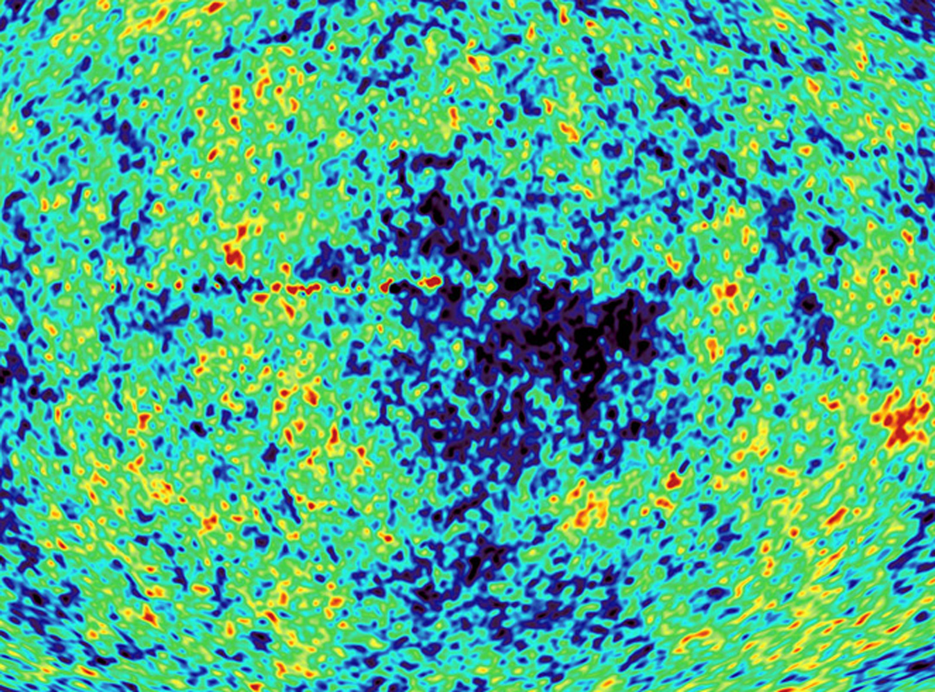
Precision cosmology, status and perspectives
2nd Galileo-XuGuangqui Ventimiglia July 13th 2010
Alessandro Melchiorri
Universita’ di Roma, “La Sapienza”

Slide 2
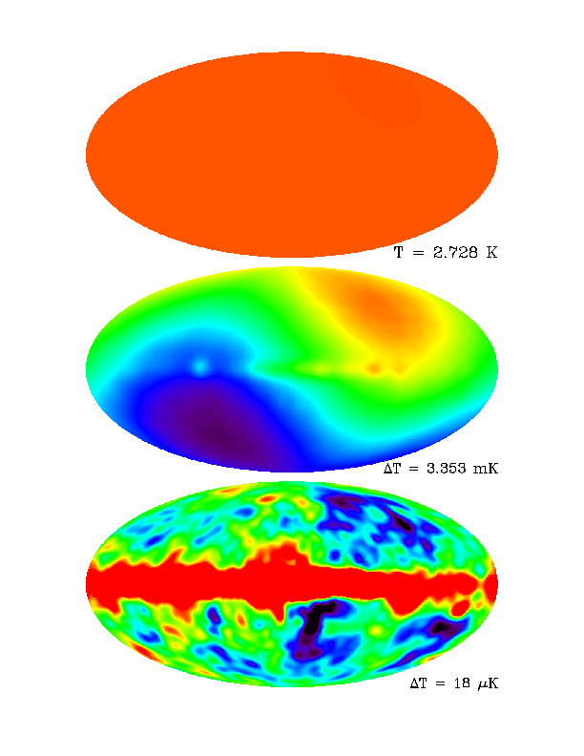
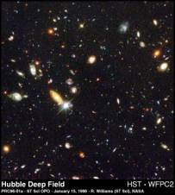
The Microwave Sky
COBE
Uniform...
Dipole...
Imprint left by primordial
tiny density inhomogeneities
(z~1000)..
Galaxy (z=0)

Slide 3
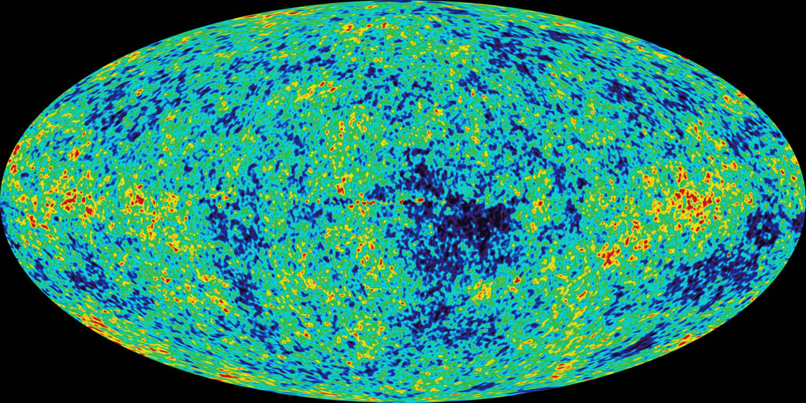
WMAP

Slide 4
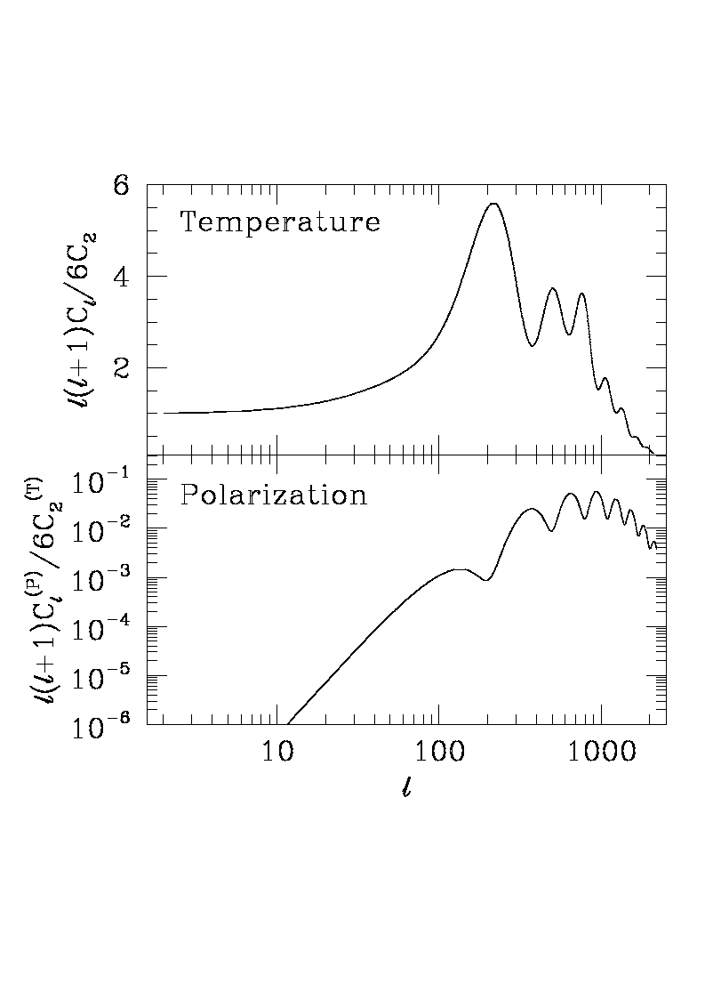
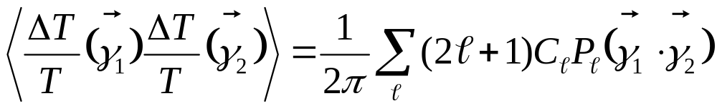
Larger scales

Slide 5
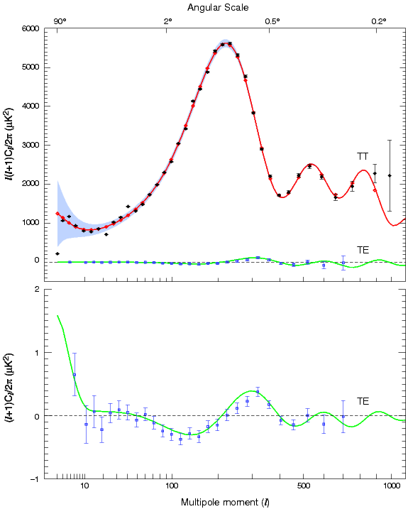
WMAP

Slide 6
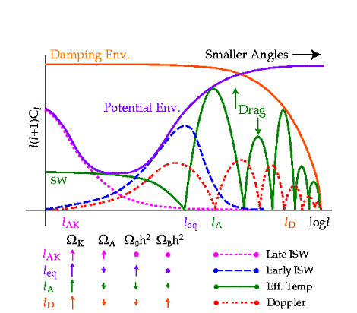
Hu, Sugiyama, Silk, Nature 1997, astro-ph/9604166

Slide 7
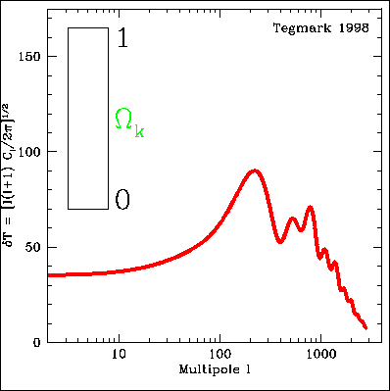
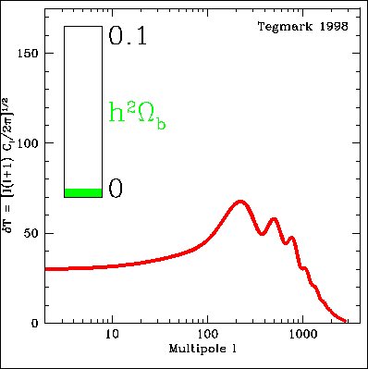
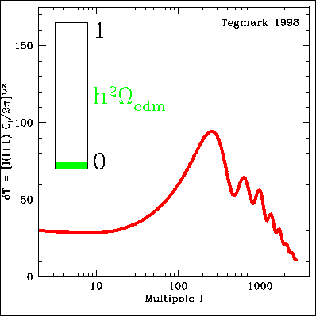
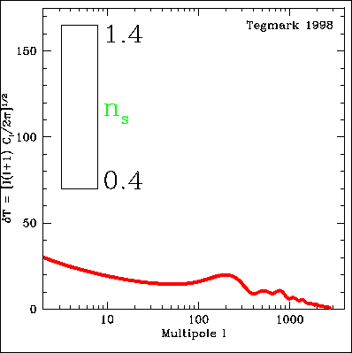
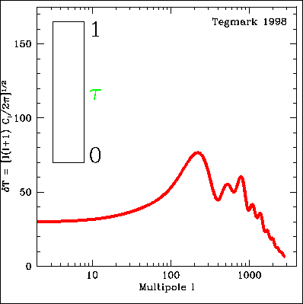
We can measure cosmological parameters with CMB !
Temperature Angular spectrum varies with
Ωtot , Ωb , Ωc, Λ, τ, h, ns, …

Slide 8


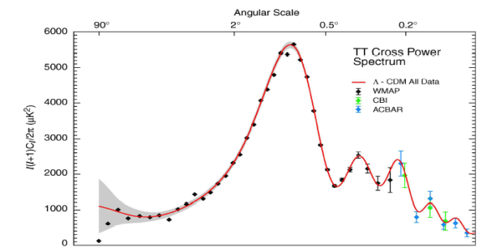
How to get a bound on a cosmological parameter
Fiducial cosmological model:
(Ω_{b}h² , Ω_{m}h² , h , n_{s} , τ, Σm_{ν} )
DATA
PARAMETER
ESTIMATES

Slide 9
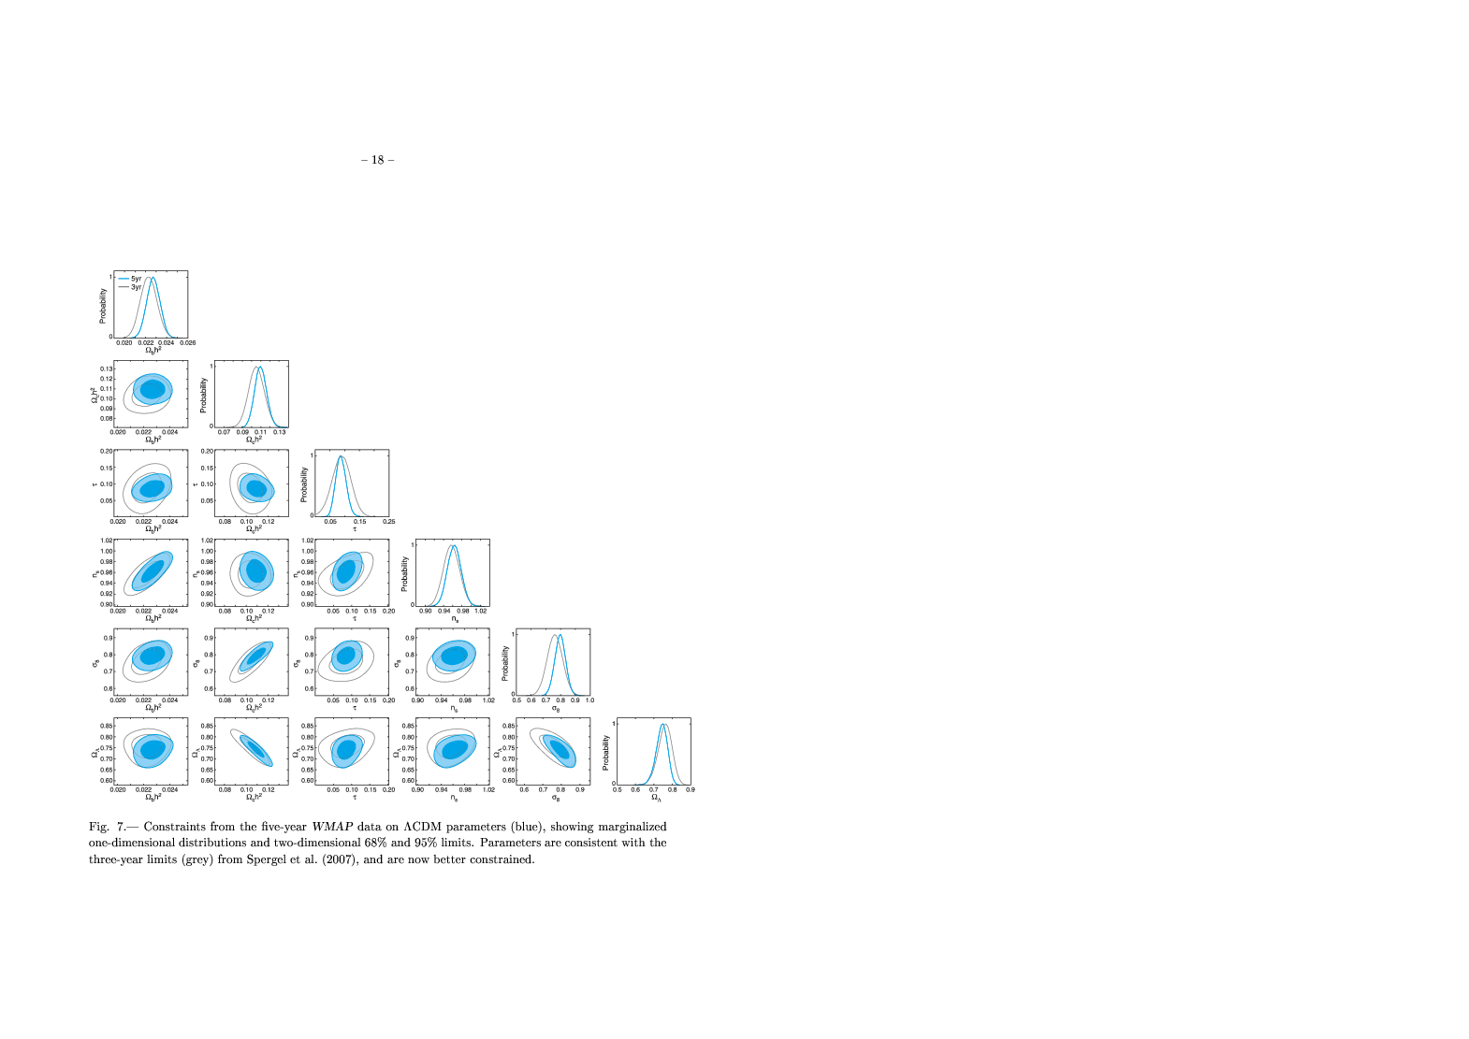
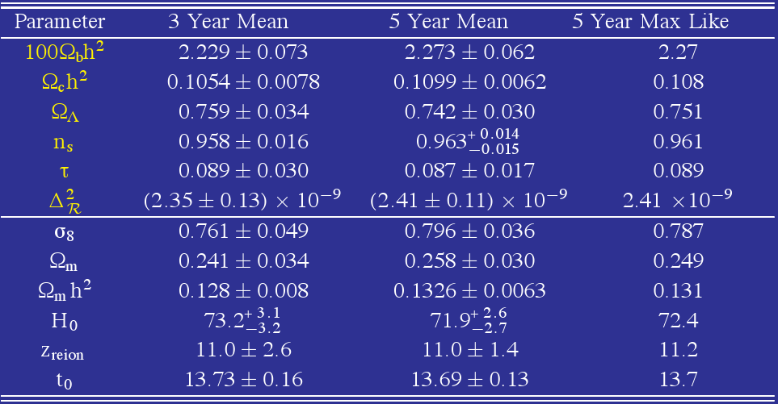
Dunkley et al., 2008

Slide 10
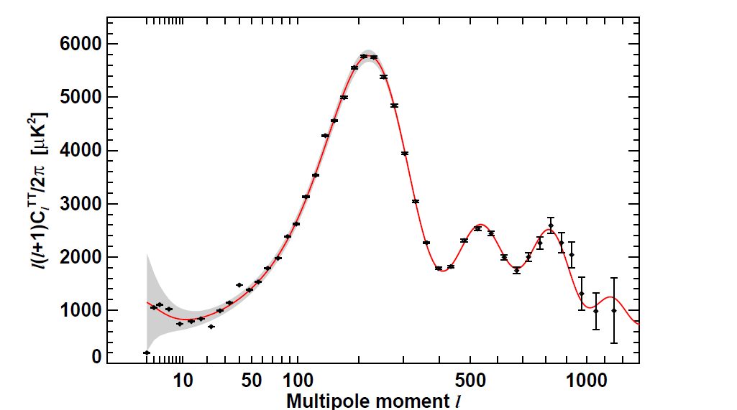
New WMAP results from 7 years of observations
Komatsu et al, 2010, 1001.4538

Slide 11
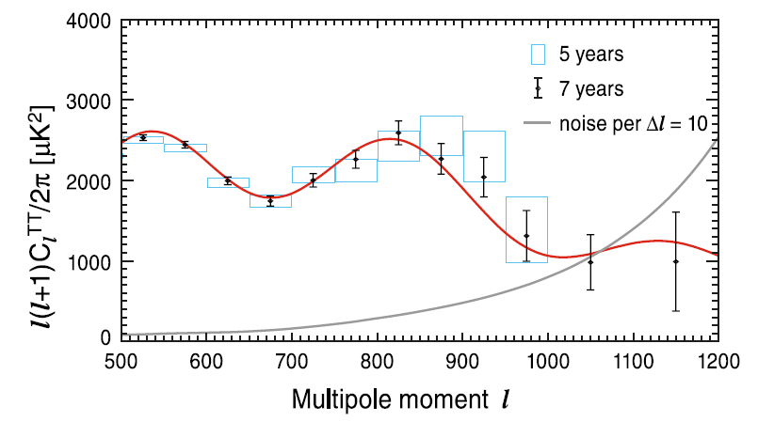

Slide 12
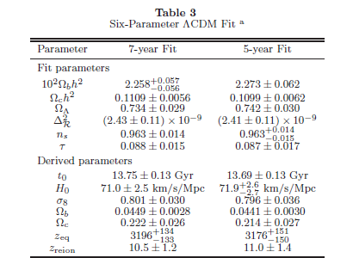

Slide 13
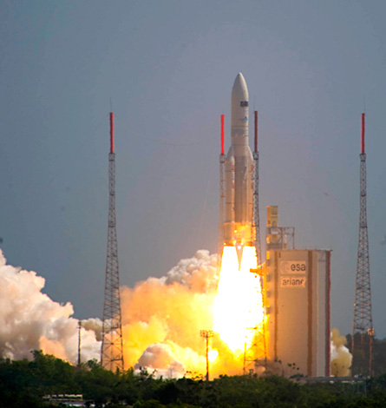
Planck
Satellite launch
14/5/2009

Slide 14
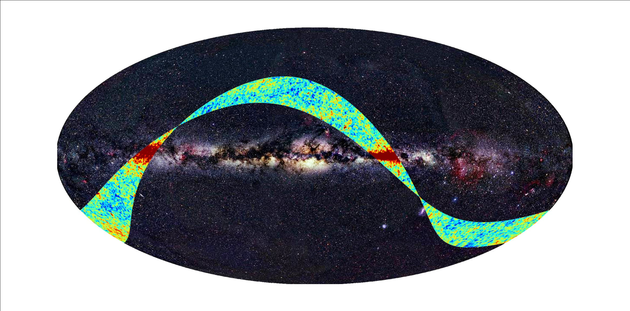
Planck First Light Survey (September 2009). Experiment is working as expected

Slide 15


Slide 16
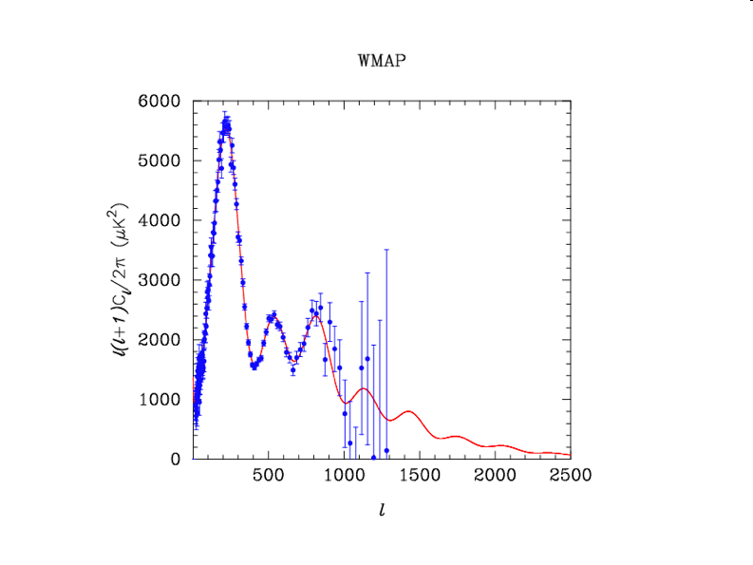
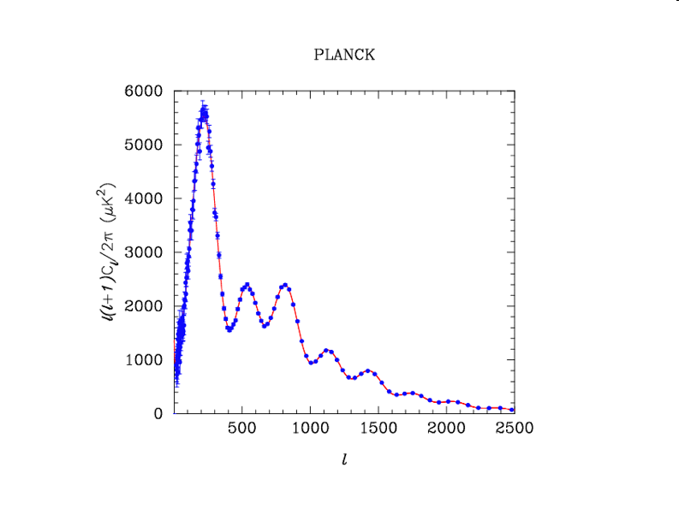

Slide 17
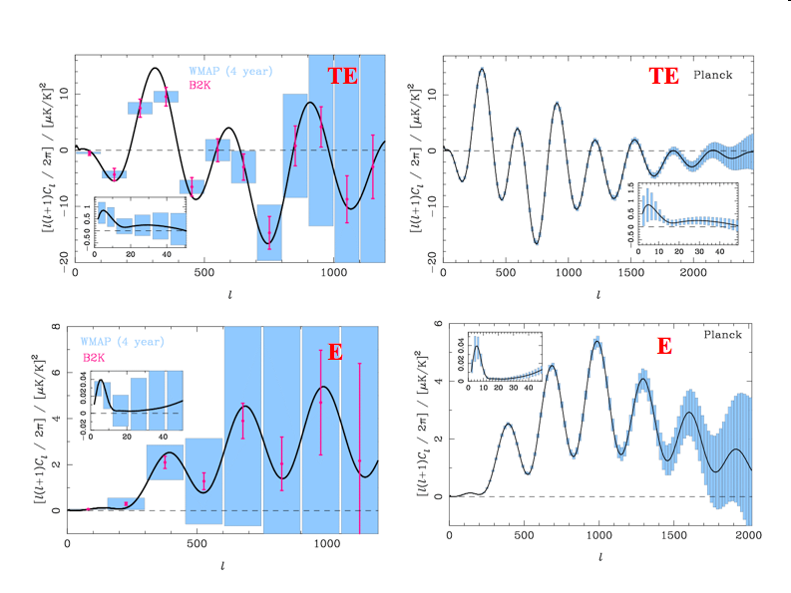

Slide 18
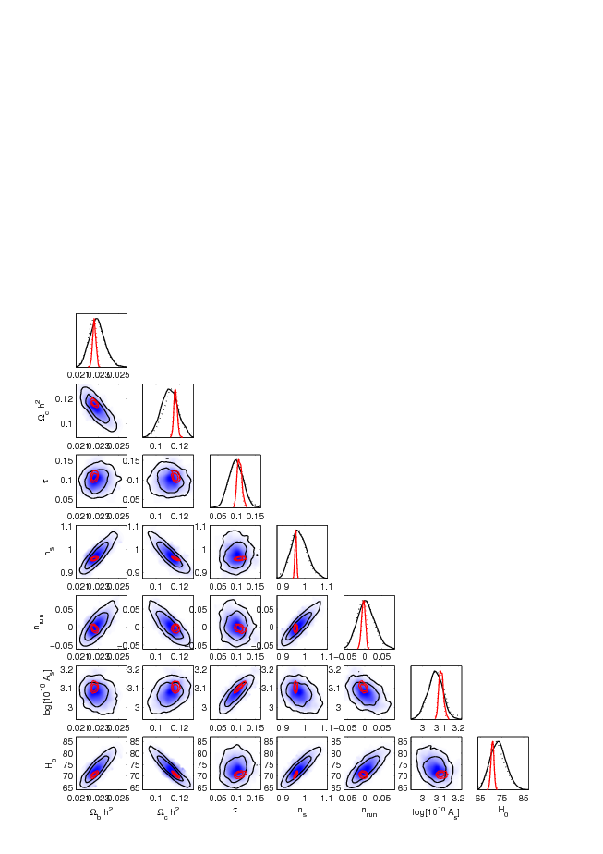
Blue: current data
Red: Planck

Slide 19
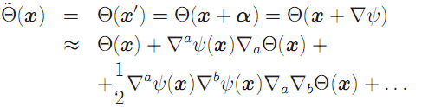
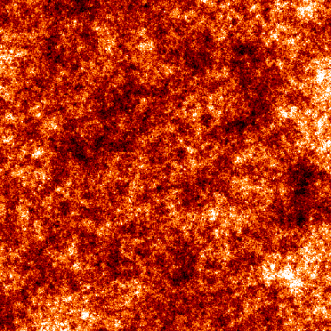
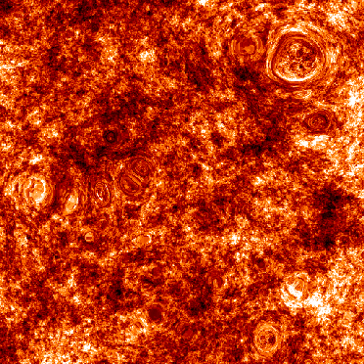
CMB Temperature Lensing
When the luminous source is the CMB, the lensing effect essentially
re-maps the temperature field according to :
unlensed
lensed
Taken from http://www.mpia-hd.mpg.de/
(Max Planck Institute for Astronomy at Heidelberg )

Slide 20

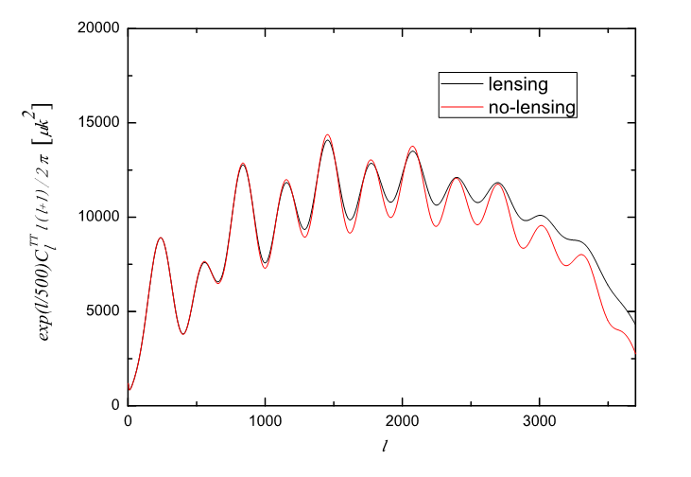
Lensing Effect on Temperature Power Spectrum
We obtain a convolution between the lensing potential power spectrum and the unlensed anisotropies power spectrum:
Where the lensing potential power spectrum is given by :
The net result is a 3% broadening of the CMB angular power spectrum acustic peaks

Slide 21
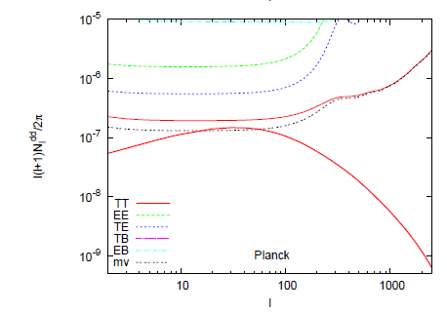
CMB Lensing and future experiments

Slide 22
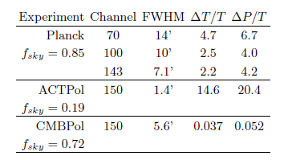
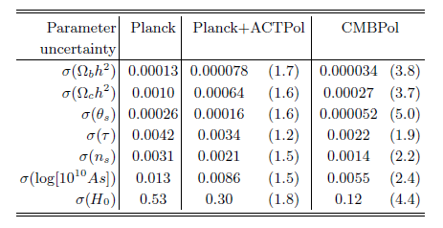
Galli, Martinelli, Melchiorri, Pagano, Sherwin, Spergel, PRD submitted,
arXiv:1005.3808 2010

Slide 23
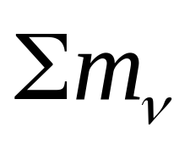
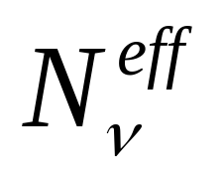
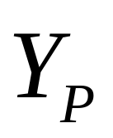
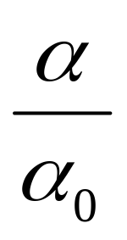
New Measurements, New Parameters !
Neutrino masses
Neutrino effective number
Primordial Helium
Fundamental Constants

Slide 24
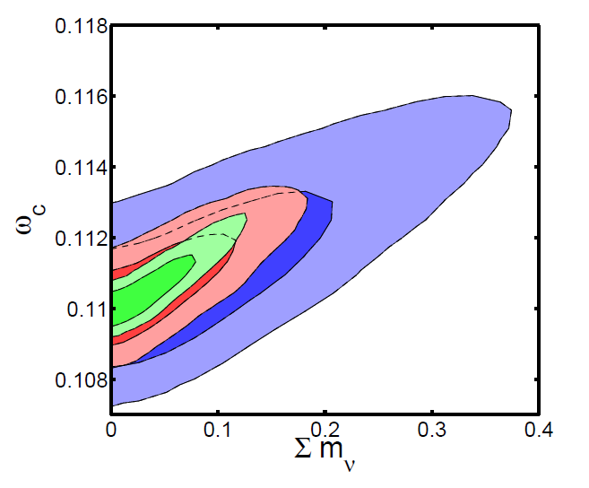
Galli, Martinelli, Melchiorri, Pagano, Sherwin, Spergel, PRD submitted,
arXiv:1005.3808 2010

Slide 25
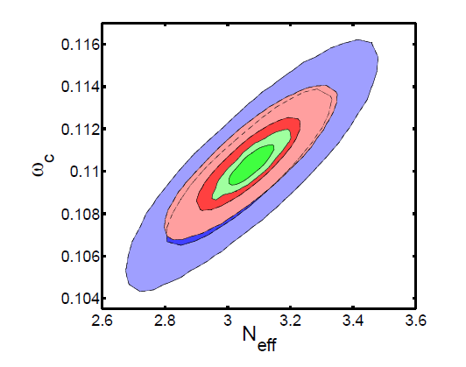
Galli, Martinelli, Melchiorri, Pagano, Sherwin, Spergel, PRD submitted,
arXiv:1005.3808 2010

Slide 26
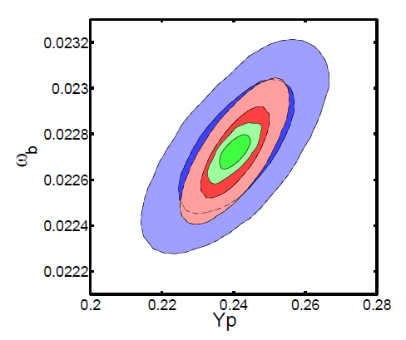
Galli, Martinelli, Melchiorri, Pagano, Sherwin, Spergel, PRD submitted,
arXiv:1005.3808 2010

Slide 27
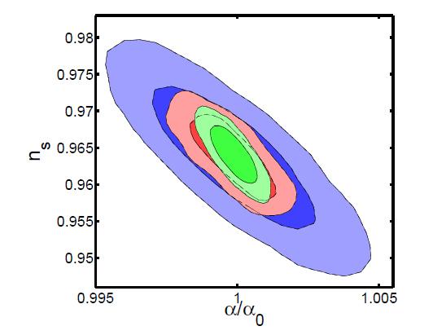
Galli, Martinelli, Melchiorri, Pagano, Sherwin, Spergel, PRD submitted,
arXiv:1005.3808 2010

Slide 28
CONCLUSIONS
Recent CMB measurements fully confirm Λ-CDM. Improved constraints on inflation
With future measurements constraints on new parameters related to laboratory
Physics could be achieved.

