Slide 1
Understanding the prompt emission of GRBs after Fermi
Tsvi Piran
Hebrew University, Jerusalem
(E. Nakar, P. Kumar, R. Sari, Y. Fan, Y. Zou, F. Genet, D. Guetta, D. Wanderman, P. Biniamini)

Slide 2
Mis-Understanding the prompt emission of GRBs after Fermi
Tsvi Piran
Hebrew University, Jerusalem
(E. Nakar, P. Kumar, R. Sari, Y. Fan, Y. Zou, F. Genet, D. Guetta, D. Wanderman, P. Biniamini)

Slide 3
OUTLINE
  Implication of Fermi’s observations of high energy emission
    Opacity limits
    Limits on the prompt emission
  GeV from external shocks

Slide 4
The expectations
A second high energy component due to Inverse Compton

Slide 5
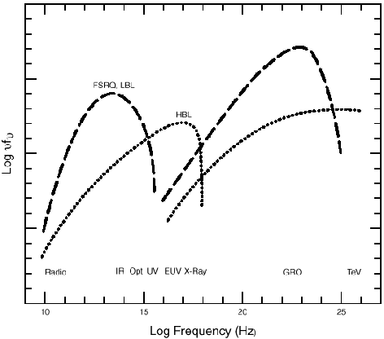
Blazar’s spectrum

Slide 6
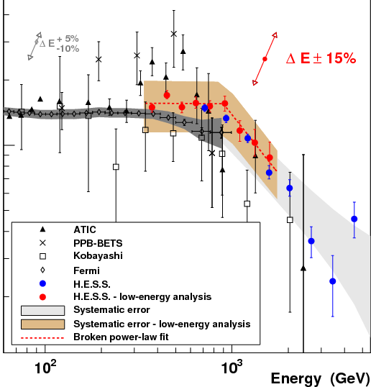
H.E.S.S. Observations of a Blazar

Slide 7
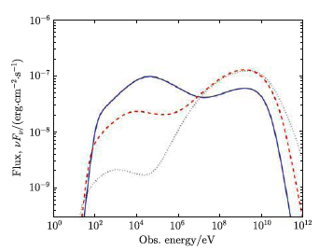
Expectations for the prompt spectrum (e.g. Fan & TP 2008)

Slide 8
Fermi’s Observations and prompt GRB emission
The origin of the prompt emission is not clear:
  Synchrotron
  Synchrotron Self Compton
  Inverse Compton of external radiation field?
  Comptonized thermal component

Slide 9
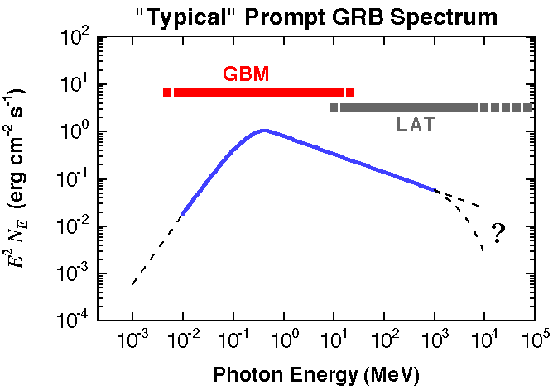
Fermi’s observations
The LAT detects ~10 GRBs/year
  17 total as of today

Slide 10
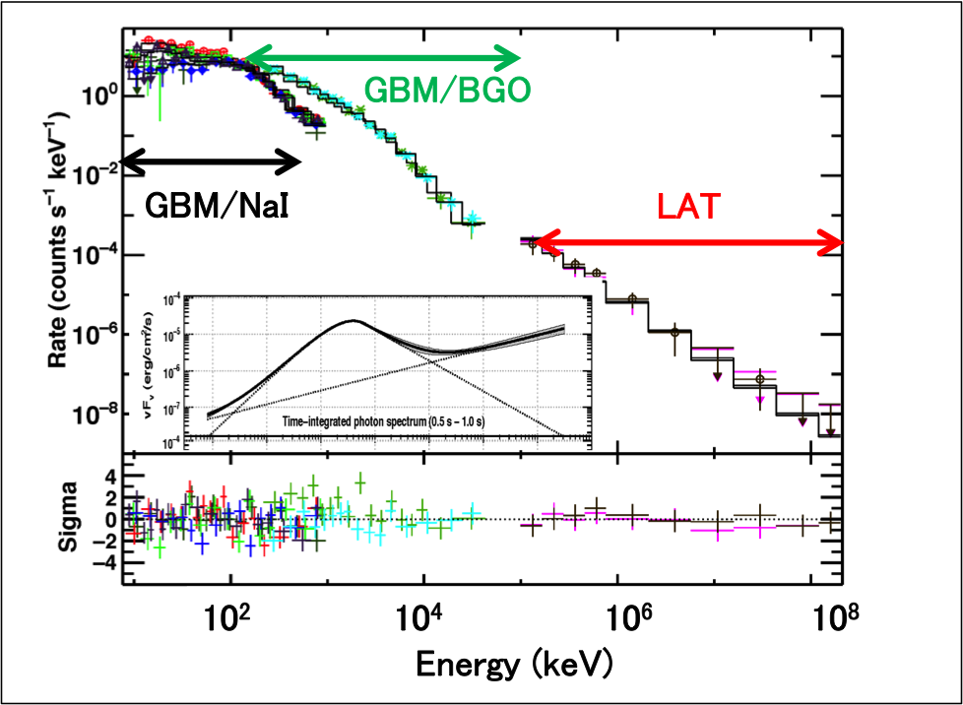
GRB090510

Slide 11
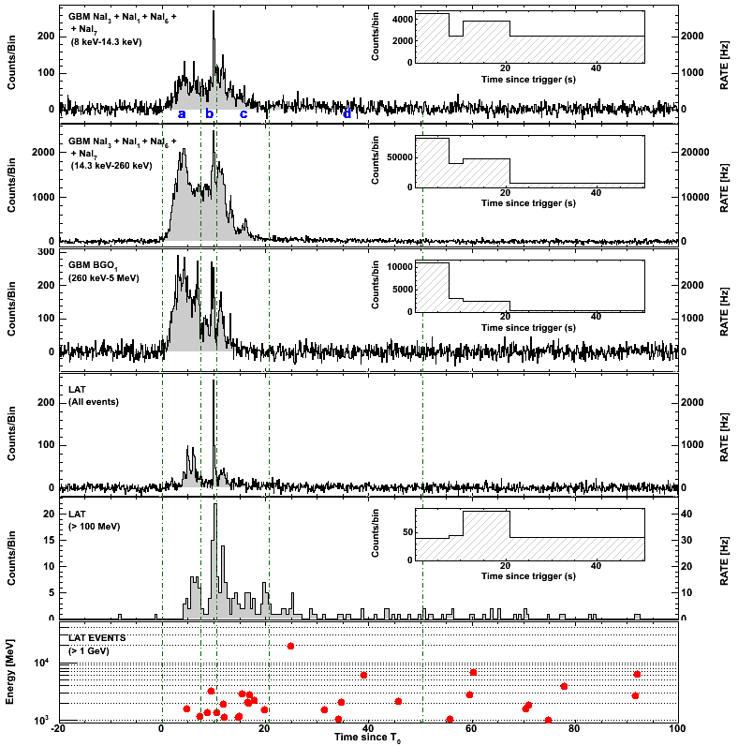
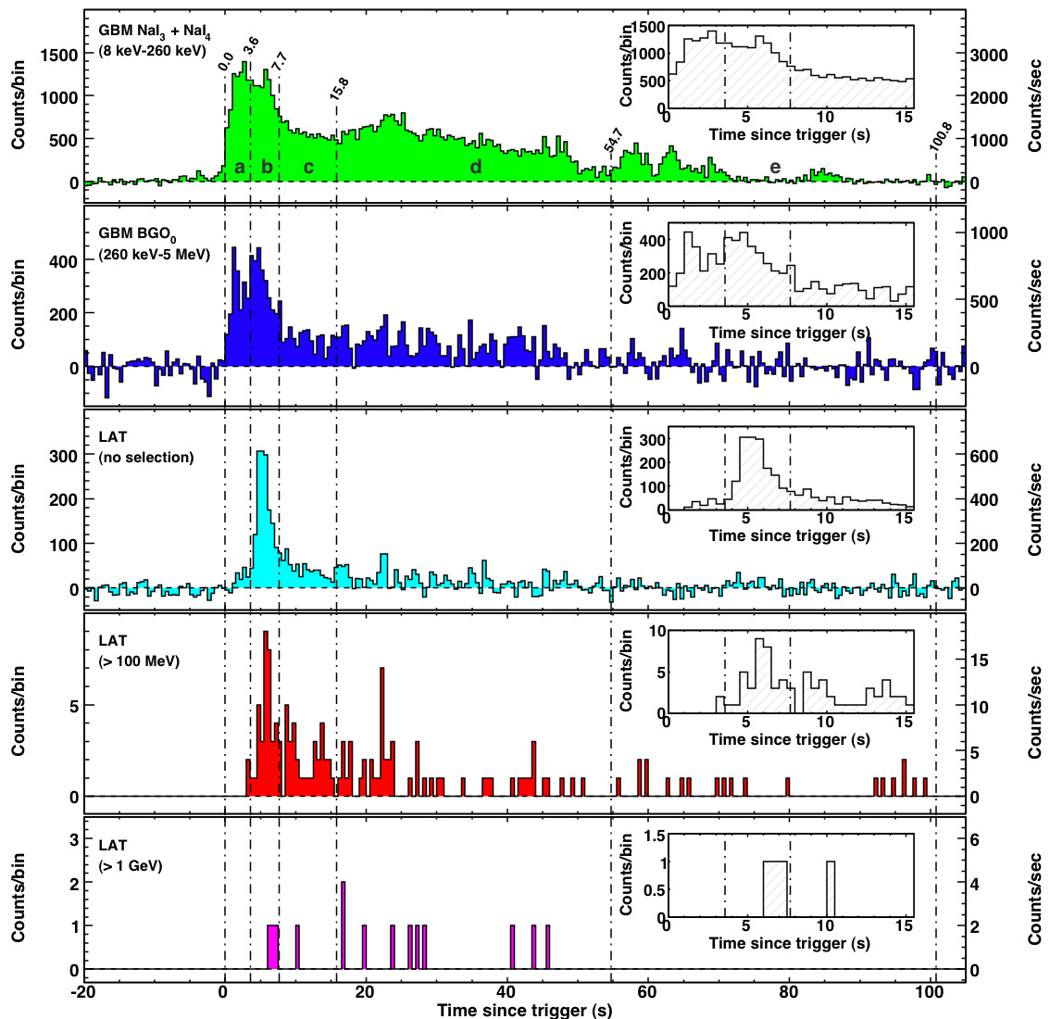
Delayed GeV emission
8-14.3keV
14.3-260 keV
0.26-5 MeV
LAT all event
>100 MeV
>1GeV

Slide 12
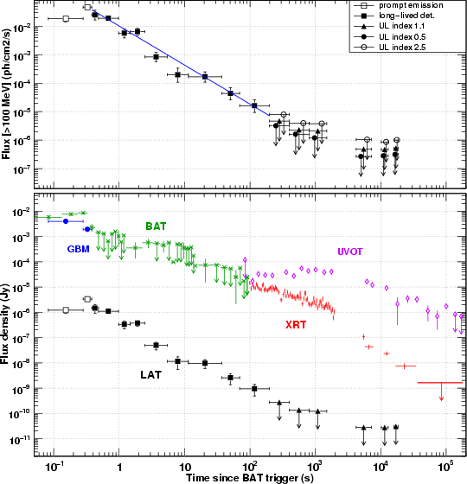
Long Lived GeV emission

Slide 13
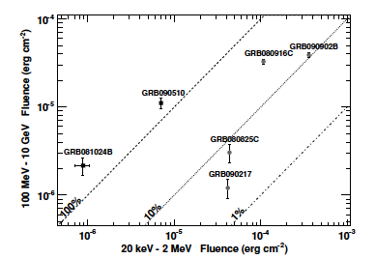
Fermi – strong upper limits on GeV emission

Slide 14
Even Stronger limits on E_{Gev}/E_{MeV}
These limits are for LAT detected GRBs.
Even stronger limits arise from LAT undetected GRBs (Guetta, Pian Waxman, 10; Beniamini, Guetta, Nakar, TP 10)

Slide 15
Limits on Synchrotron Parameters
This rules out the γ_{e} ≈100 electrons in the region that emits the prompt γ-rays

Slide 16

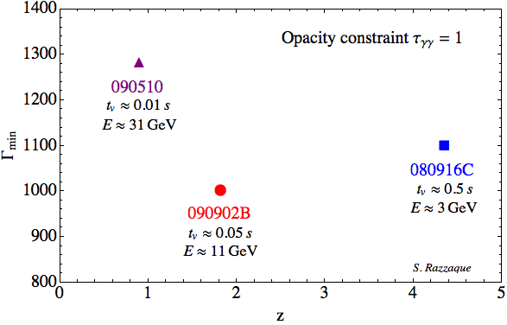
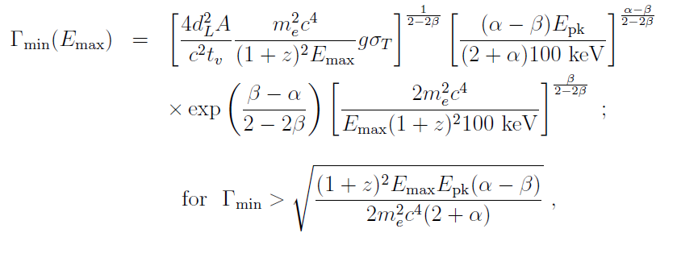
Limit on bulk Lorentz factor
Due to large luminosity and small emitting region, optical depth for the
γ-γ -> e+e- pair production is too large to observe the non-thermal
emission from GRB → compactness problem.
Relativistic motion (Γ>>1) could avoid this compactness problem
Γ_{min}
Γ_{min} can be derived using observed
highest energy photon
090510
E=31 GeV
080916C
E=3 GeV
090902B
E=33 GeV
z
Γ_{min}~1000 for short and long GRBs

Slide 17
New Limits on the Lorentz factor
(with Y. Fan and Y. Zou)
Opacity limits on Γ should take into account the possibility of a different origin of the prompt low energy γ-rays
This may reduce significantly the limits on Γ
Γ
Γ₁
e⁺
e_

Slide 18
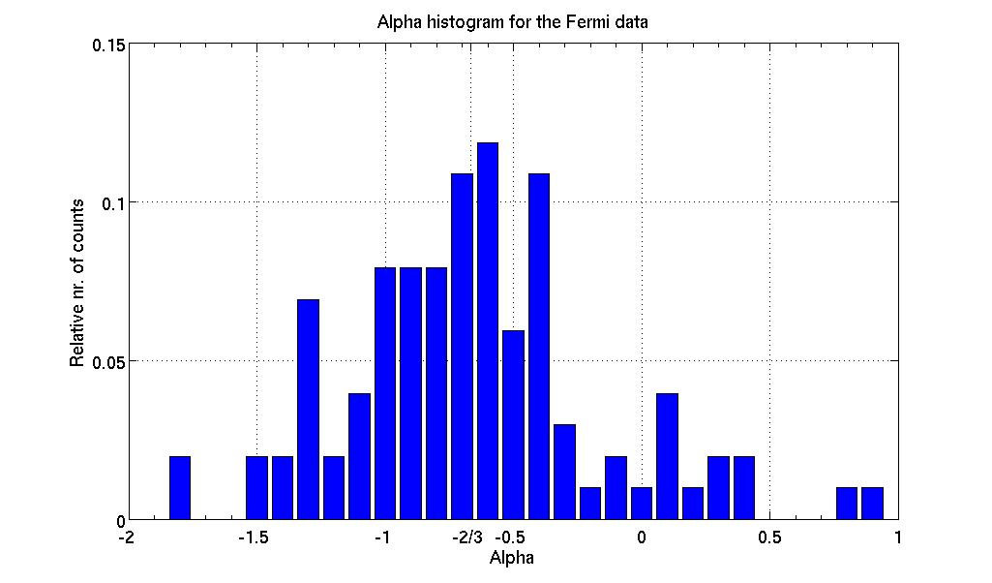
Fermi’s α distribution (GCN parameters)
The synchrotron “line of death” problem persists!

Slide 19
The origin of the prompt emission is not clear:
  Synchrotron – “line of death”
  Synchrotron Self Compton
  Inverse Compton of external radiation field?
  Comptonized thermal component

Slide 20
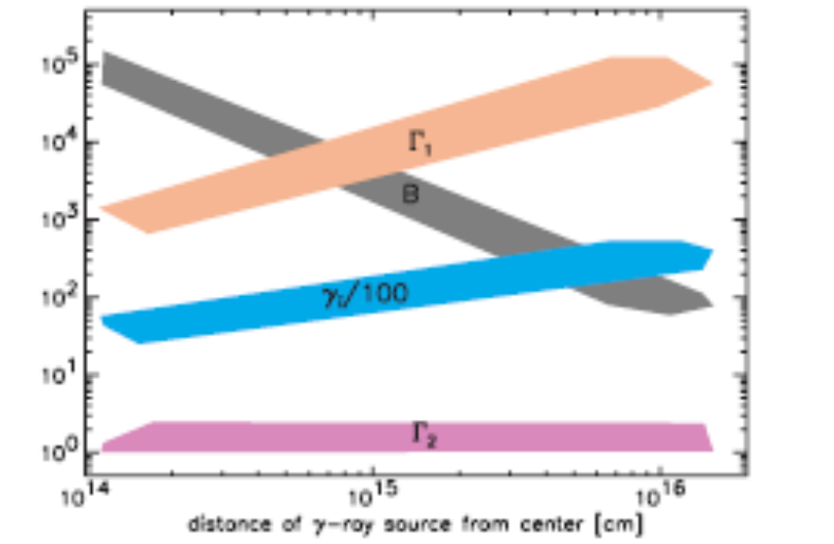
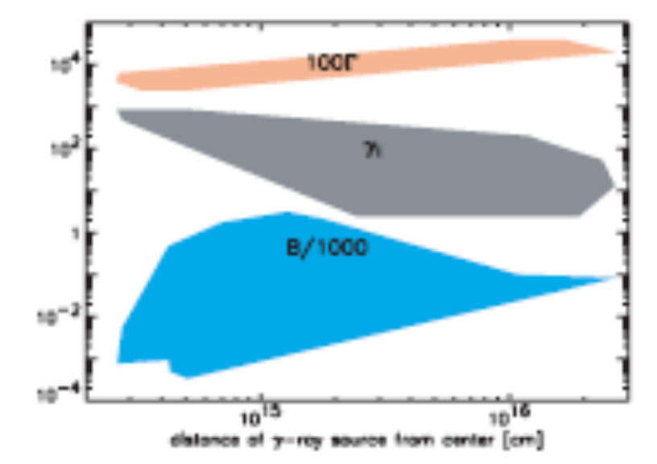
SSC or IC ?
Mon. Not. R. Astron. Soc. 367, L52–L56 (2006) A unified picture for gamma-ray burst prompt and X-ray afterglow emissions
P. Kumar E. McMahon, S. D. Barthelmy, D. Burrows, N. Gehrels, M. Goad, J. Nousek and G. Tagliaferri
Synch
SSC

Slide 21
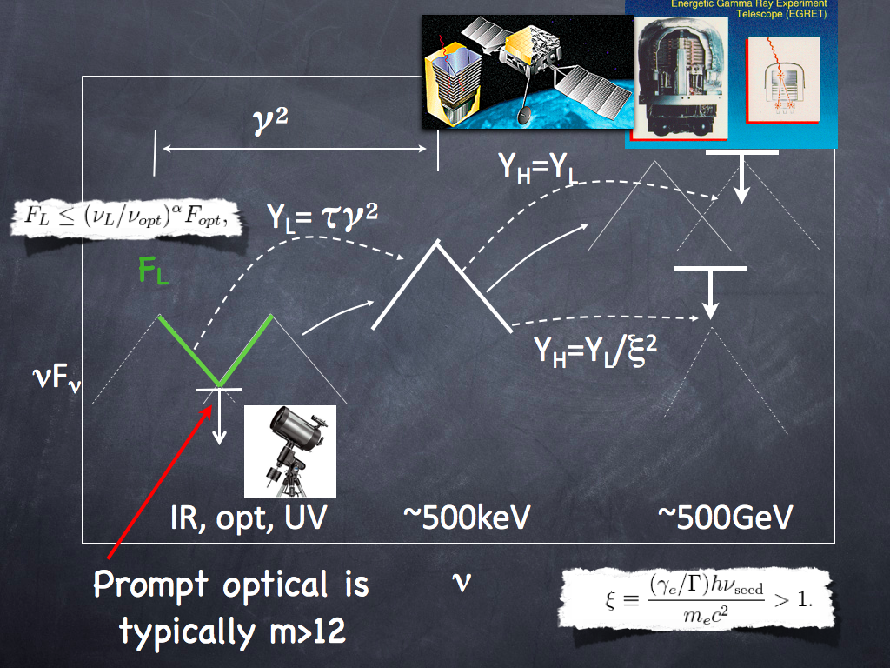

Slide 22
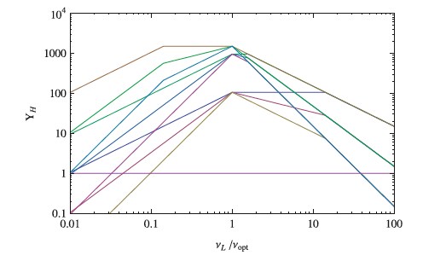

Slide 23
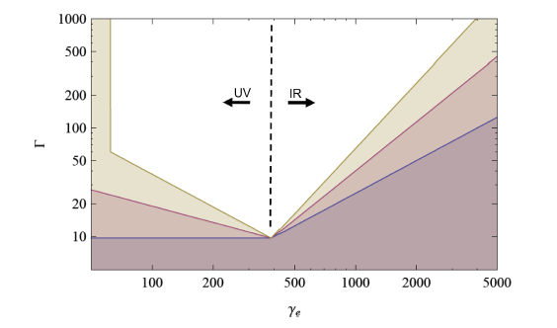
Rules our regions in the Parameter phase space

Slide 24
Pair Avalanche

Slide 25
The origin of the prompt emission is not clear:
  Synchrotron – “line of death”
  Synchrotron Self Compton – GeV emission is too weak
  Inverse Compton of external radiation field? – No reasonable source of seed photons (Genet & TP)
  Comptonized thermal component – Not clear how to produce the needed mildly relativistic electrons at the right location (see however Beloborodov 2010)

Slide 26
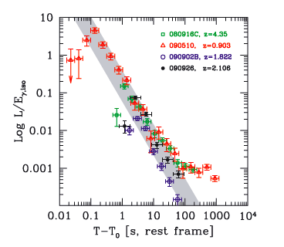
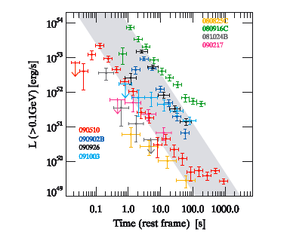
The origin of the GeV emission?
From Ghisellini et al 2010

Slide 27
Lessons from “Undetected” LAT Bursts?
Biniamini, P., Guetta, D., Nakar, E. & TP
When we sum up data from 20 GBM burst with fluence just below the fluence of LAT detected GBM (and θ<70) we find a clear statistically significant signal.
The tail (T-T₀>100sec) is stronger than the prompt (T-T₀<100sec) .
Preliminary

Slide 28

The Afterglow
Afterglow
γ-rays
Inner
Engine
Relativistic
Wind
Internal
Shocks
External
Shock
10⁶cm
10¹³-10¹⁶cm
10¹⁶-10¹⁸cm

Slide 29
Afterglow Theory
Hydrodynamics: deceleration of the
relativistic shell by collision with the surrounding medium (Blandford & McKee 1976)
(Meszaros & Rees 1997, Waxman 1997, Sari 1997, Cohen, Piran & Sari 1998)
Radiation: synchrotron + IC (?)
(Sari, Piran & Narayan, 98 and many others)
Clean, well defined problem.
Few parameters:
E, n, p, e_{e}, e_{B} (~10⁻²)
initial
shell
ISM

Slide 30
Can the forward shock synchrotron produce the observed GeV emission?
Kumar and Barniol-Duran - Yes (adiabatic)
Ghisellini, Ghirlanda, Nava, Celloti - Yes (radiative)

Slide 31
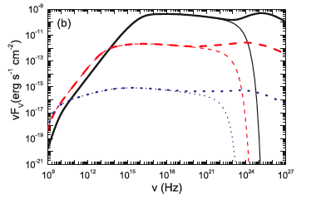
Standard External Shock Spectra
Fan, TP, Narayan & Wei, 2008
When we lower B
SSC
200 s
Synch
2 10⁴ s
2 10⁶ s

Slide 32
But
TP & Nakar 2010, Kumar Barniol-Duran 2010
Cooling time = acceleration time
=> Upper limit on synchrotron photons
=>
But 33 GeV photons at 82 sec from GRB090902B
Much worse in a radiative cooling when Γ(t) decreases much faster.

Slide 33
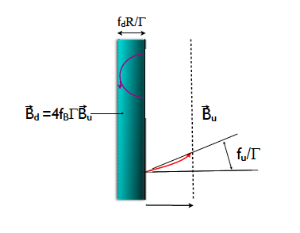
Cooling and Confinement TP & Nakar 10,Kumar Barniol-Duran, Zhou 10, Waxman & Zhou 06
Downstream dominates cooling
Upstream dominates confinement

Slide 34
Cooling and Confinement
Cooling - MeV < hν_{c} < 100 MeV
=> f_{B} B > 85 μG (t/100)^{-1/6} for
Confinement of the electrons producing 10GeV photon
=> B > 20 μG (t/100)^{-1/12}

Slide 35
Oops - Cooling by IC
Even a modest (a few μJ) IR or optical flux will cool (via IC the synch emitting electrons)

Slide 36
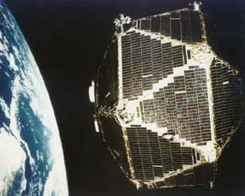
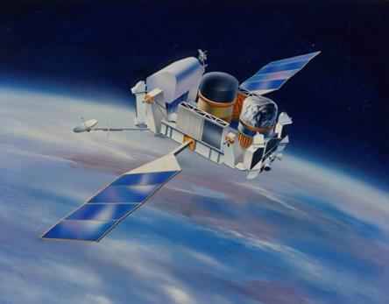
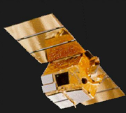
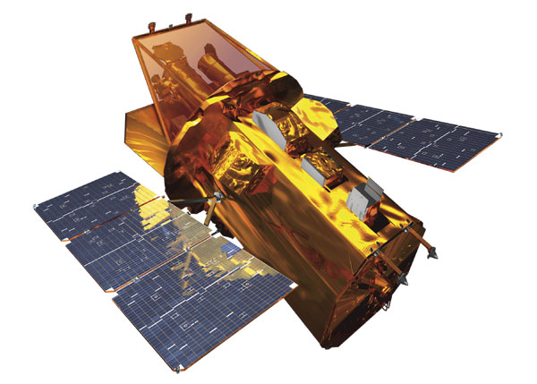
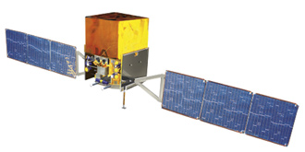
One slide before last
Vela
BATSE
BeppoSAX
Swift
Fermi

Slide 37
Some Conclusions
Revise minimal Γ opacity estimates
Prompt emission mechanism
  Not SSC (lack of high energy signature + not enough optical seed).
  NOT IC – no relevant seed source
  Synch – “line of death”, Fermi limits on emitting elns
  Mildly relativistic comptonization ?
The GeV emission
  Mostly external shocks
    No late energetic photons
    No simultaneous strong IR or optical

